Slide 1
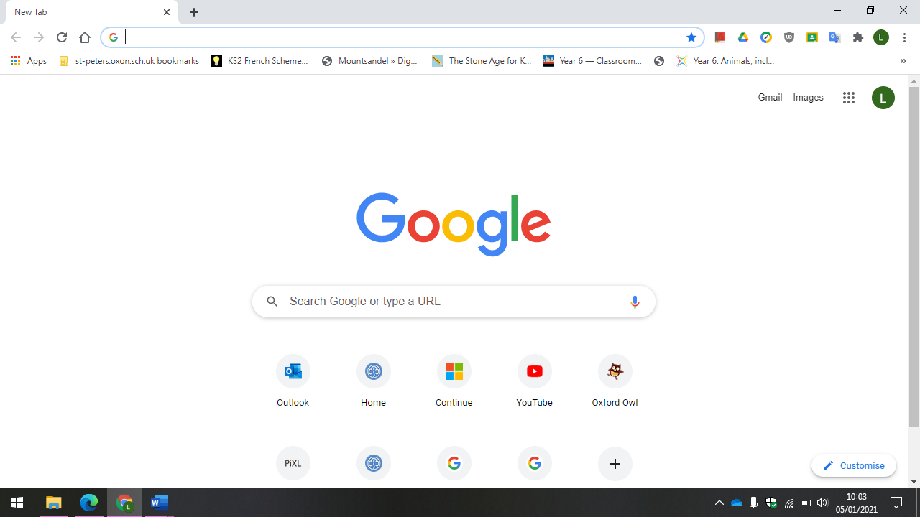
To log in to Google classroom, you first need to log into Google by clicking on the coloured circle in the corner – it may even say sign in if you don’t already use a Google account.

Slide 2
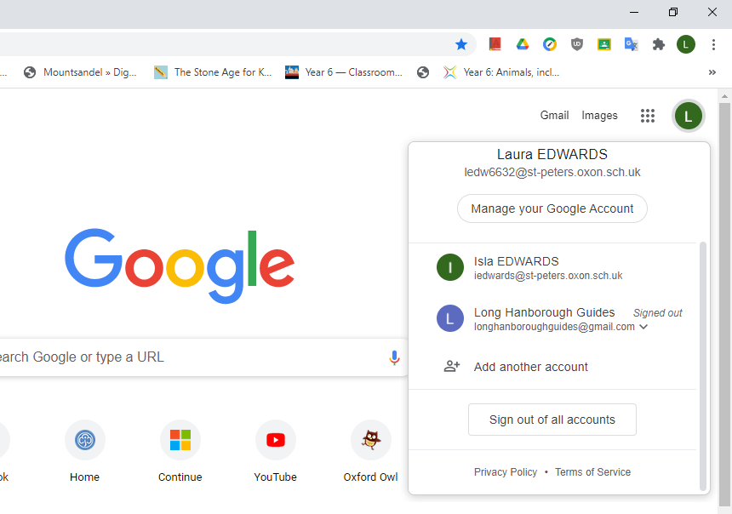


There will be a drop down menu to add another account.

Slide 3
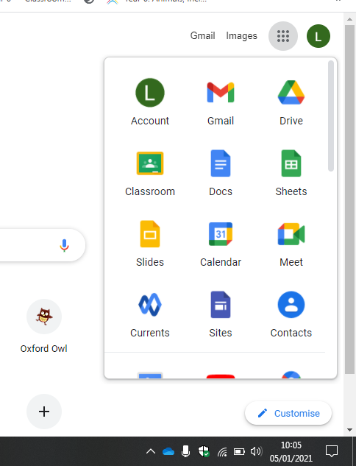
Click onto the ‘waffle’ in the corner to find all of your classroom apps.
Drive – will be where your files are stored.
Classroom is where all the lessons are posted from your teachers.
Docs is the google equivalent of Word and slides is the equivalent of PowerPoint.
Your login details for Google are:
Your 1st initial + your surname ( lowercase)
e.g. ledwards
Followed by: st-peters@oxon.sch.uk.
So it should look like: ledwards@st-peters.oxon.sch.uk
The password is :stpeters (lowercase)

Slide 4
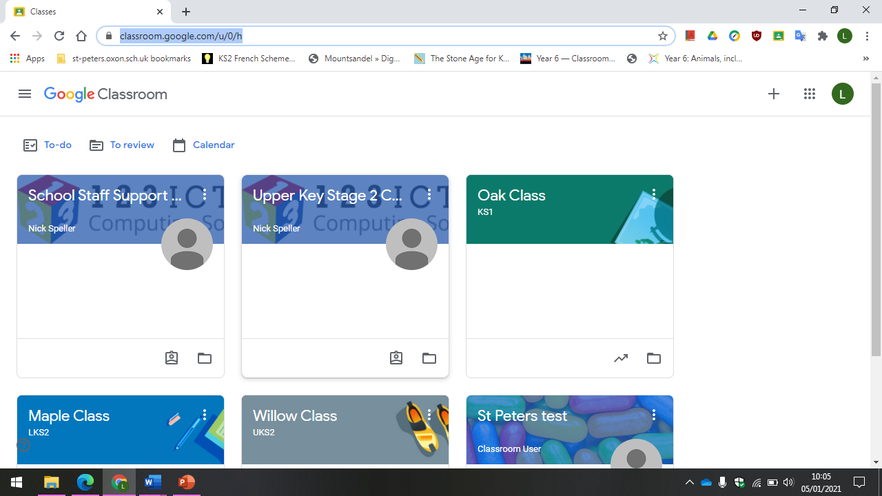
When you click onto classroom you will then be able to click into your class.

Slide 5
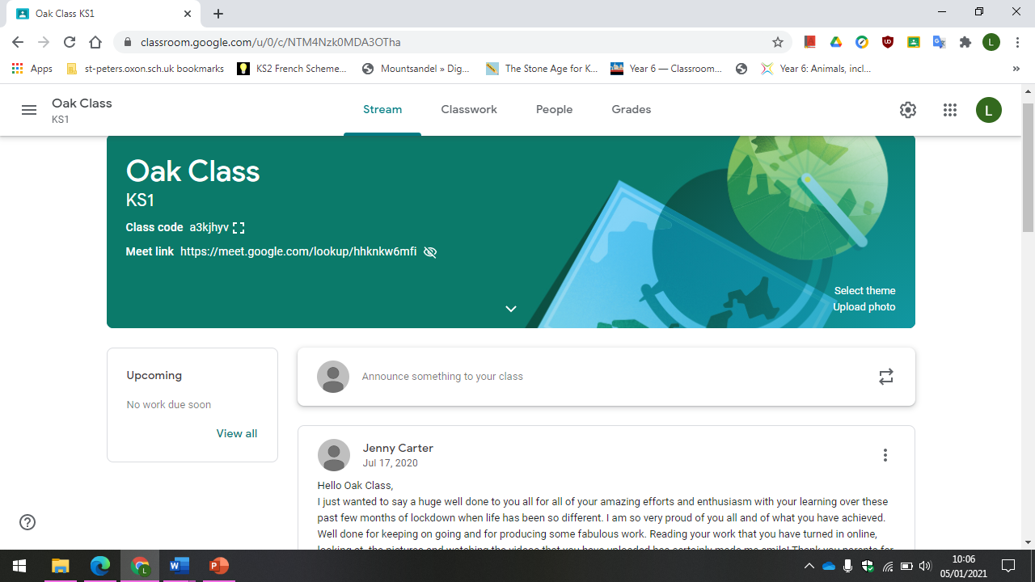
When you open up classroom you will see the class ‘stream’ where the teachers can write comments and you can see work that is set up.

Slide 6
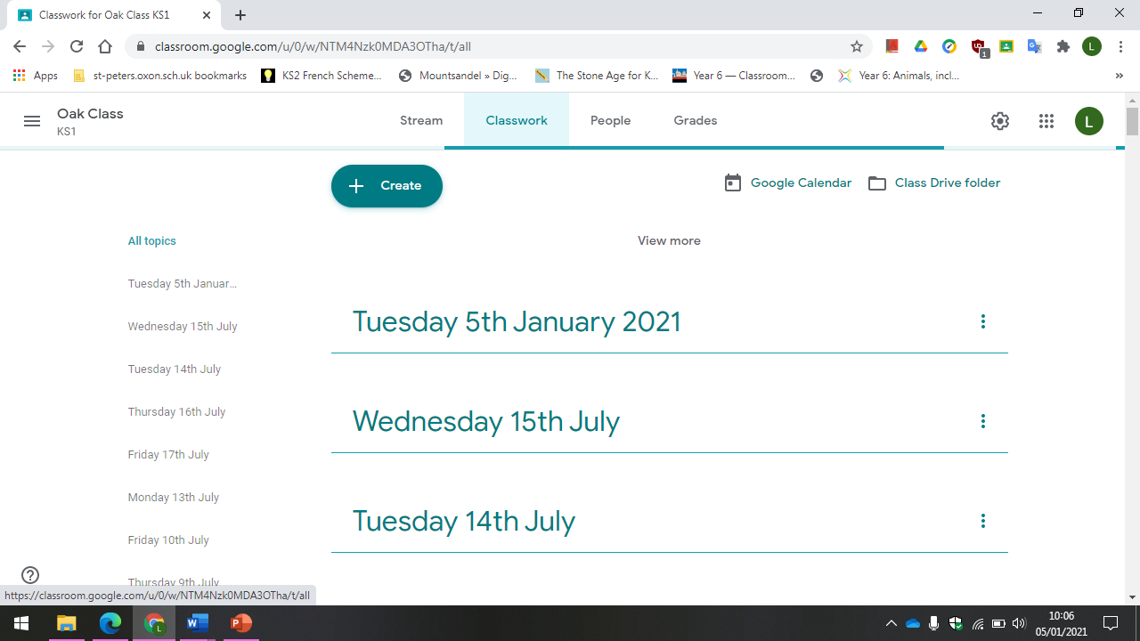
By clicking on the classwork tab you can see the work that has been set.

Slide 7
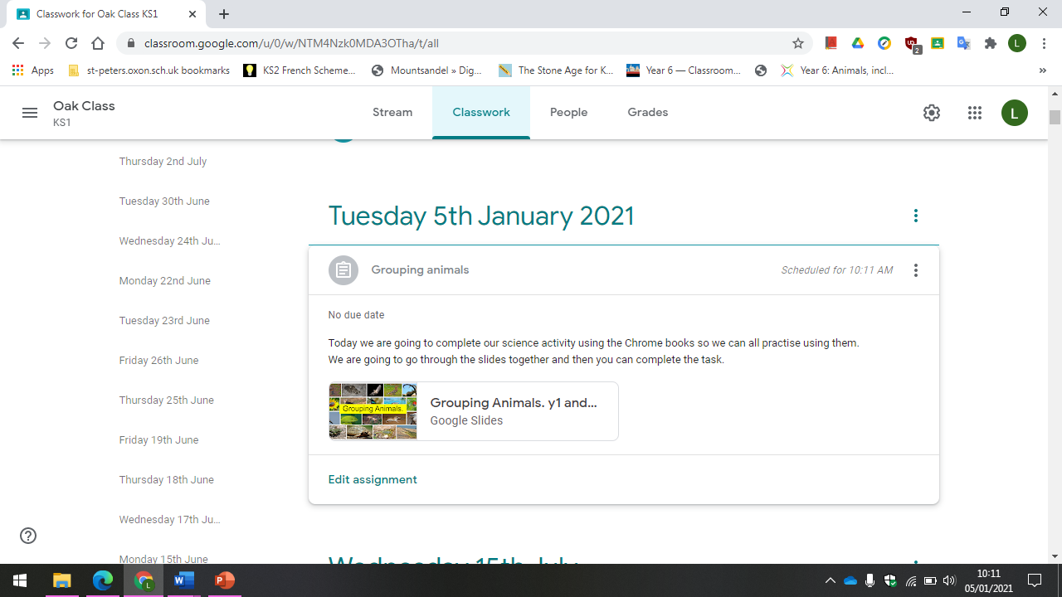
You can click on view the assignment to get the details for each piece of work.

Slide 8
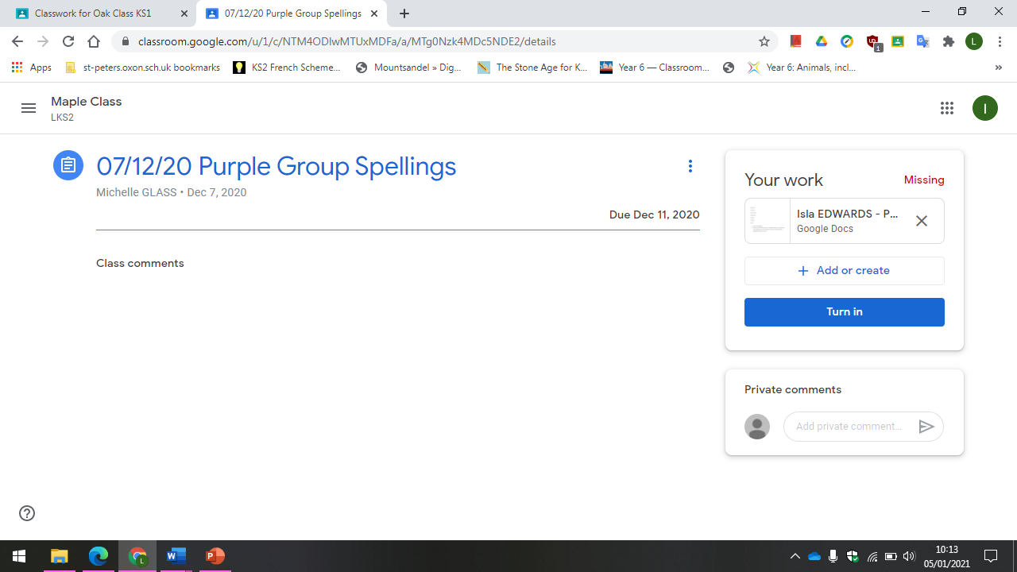
Here is where work set by teachers can be edited or your own documents can be attached.
When you are in an assignment there may be documents attached or videos to watched.
When the work has been completed/ attached remember to hit the turn in button!

