Slide 1
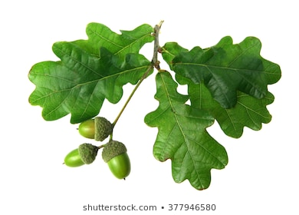
Welcome to Oak Class Parents Afternoon

Slide 2
Weekly Timetable Details
Mrs Bradley Monday – Wednesday; Mrs Carter Thursday & Friday
Spellings are tested on: Mondays (Y1) & Thursdays (Y2)
P.E. will be on Thursdays/Fridays.
Forest School is on Wednesday afternoons with Mrs Houghton.
Children should have their P.E. kit in school throughout the week. (shorts and t-shirt for indoors; tracksuit bottoms, t-shirt, sweatshirt and trainers for outdoors)
Please drop your children off on the playground, at the bottom of the ramp to Oak Class. If necessary you can come into the cloakroom, but strictly no entry into the classroom.

Slide 3
It would be a great help if …
Everything could be named!
Children could have a change of shoes/wellies for playtimes when they are on the field
No party invitations are given out at school -in the classroom. Sorry – but they just lead to tears!!

Slide 5
Tuesday 15th or 22nd October
Fairy Tales
Dressing Up Day

Slide 6
Homework
1.Reading (Books can be changed Mondays, Wednesdays and Fridays)
2.Spelling (Y2 given out on Fridays, Y1 on Tuesdays)
No need to write sentences.
3. A topic project now and again later in the year.

Slide 7
Reading
Volunteer readers each day
Each child will read at least once to an adult each week. More frequent slots will be added in if necessary
Reading is taught as a whole class, mixed ability lesson with differentiated tasks.
Comprehension - focuses on inference, deduction, making predictions, discussing author choice

Slide 8
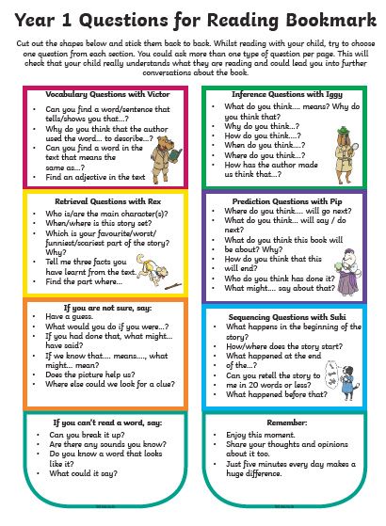

Slide 9
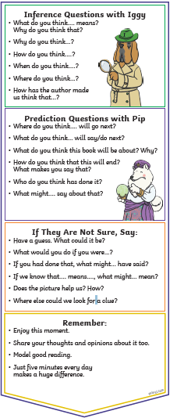


Slide 10
General Weekly Practise at home
Phonics sounds (Year 1)
Reading (x3 – x5 every week)
Books must be read twice – excluding chapter books.
3. Number bonds to 10 practise (5+5 6+4)
4. Times tables x2 x5 x10

Slide 13
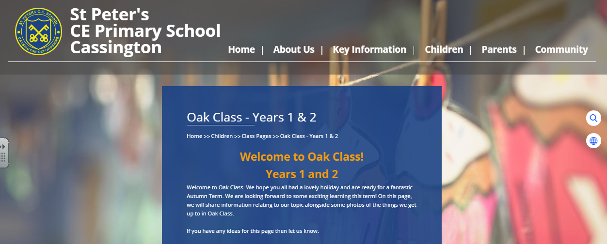
Keep an eye on the Oak Class page of the school website.
https://www.st-petersoxon.co.uk/oak-class-years-1-2/

