Slide 1
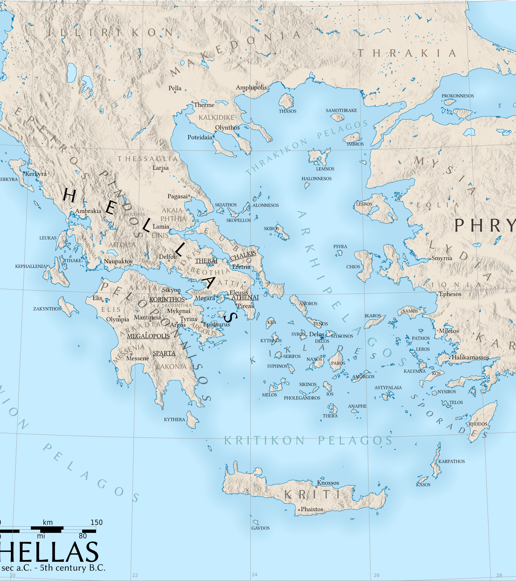
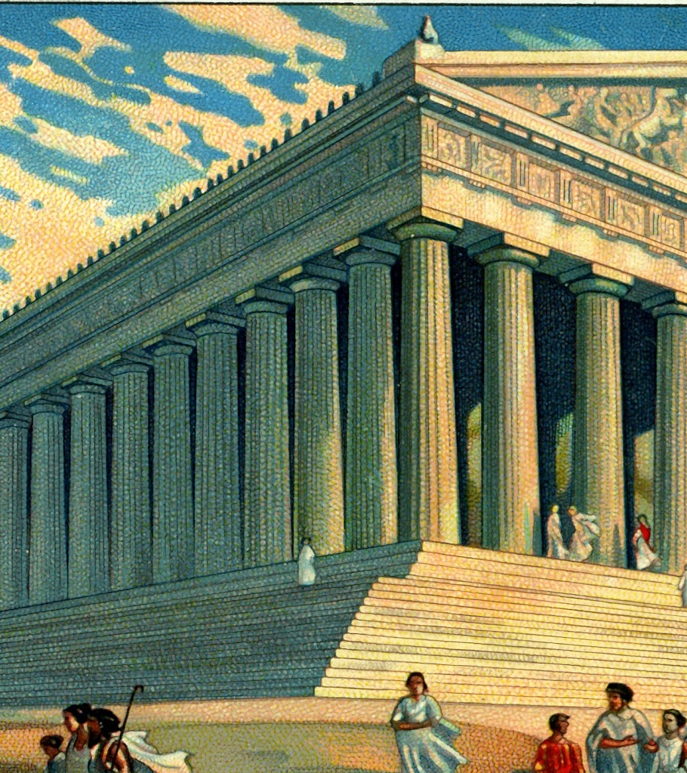
Ancient Greece

Slide 2
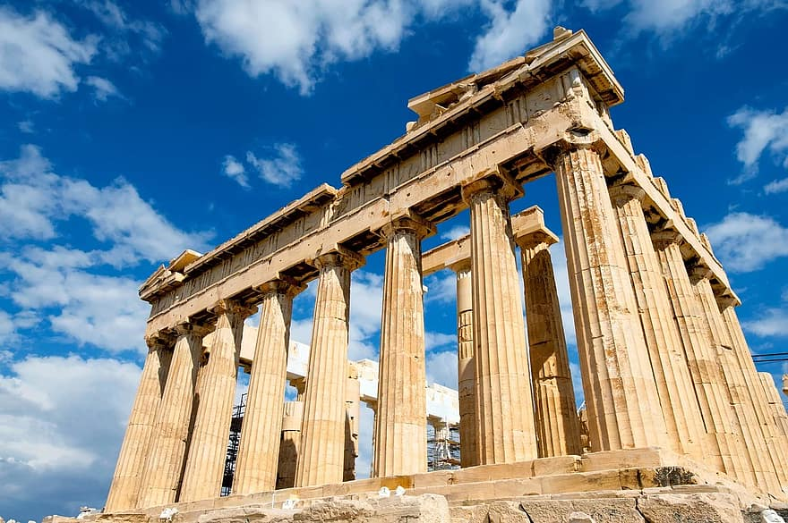
The Parthenon!
The parthenon is made of marble and was built between 447 and 432 BC.
The parthenon was converted into a christian church.
The Parthenon was built by two people their names were Ictinus and Callicrates. The temple was mainly created for their goddess Athena.
The parthenon is over 2466 years old.
The parthenon was built in Athens.

Slide 3
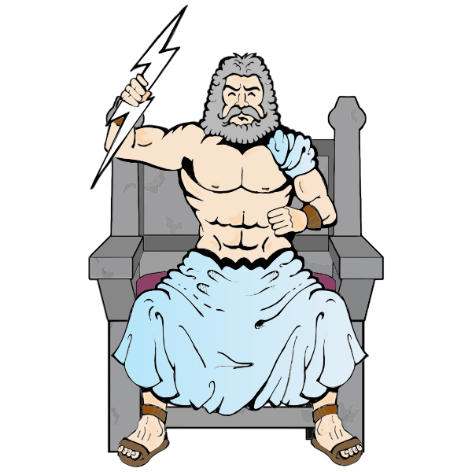
Gods!
The greeks worshiped many gods.
Zeus: king of the gods. God of sky and air
Hera: Zeus's wife, she is jealous. Goddess of marriage
Athena: The parthenon was built for her. Goddess of wisdom
Aphrodite: Goddess of beauty and love
Artemis: Goddess of hunting
Demeter: goddess of harvest and nature
Hestia: Goddess of hearth
Apollon: god of poetry, music, sun
Ares: god of war
Hephaistos: god of blacksmiths
Hermes: messenger of the gods
Poseidon: god of the sea
( there are more gods than this)

Slide 4

~The Greek Olympics!~
Rules:
Only men ( not slaves) that could speak greek were allowed to compete.
Once you enter you can not leave the olympics.
Married women are not allowed to watch.
No one can start earlier than other competitors.
if people disobeyed the rules then they would have to pay a fine and the money would help build statues of Zeus or they’d get whipped.
If married women were found watching the Olympics, they would be thrown off Mountain Typaion.
The Greek games included~
Pentathlon
Running
Jumping
Discus throw
Wrestling
Boxing
Pankration
Equestrian events
The modern olympics started in 1896
The sports activities were mainly for their king god Zeus.

Slide 5
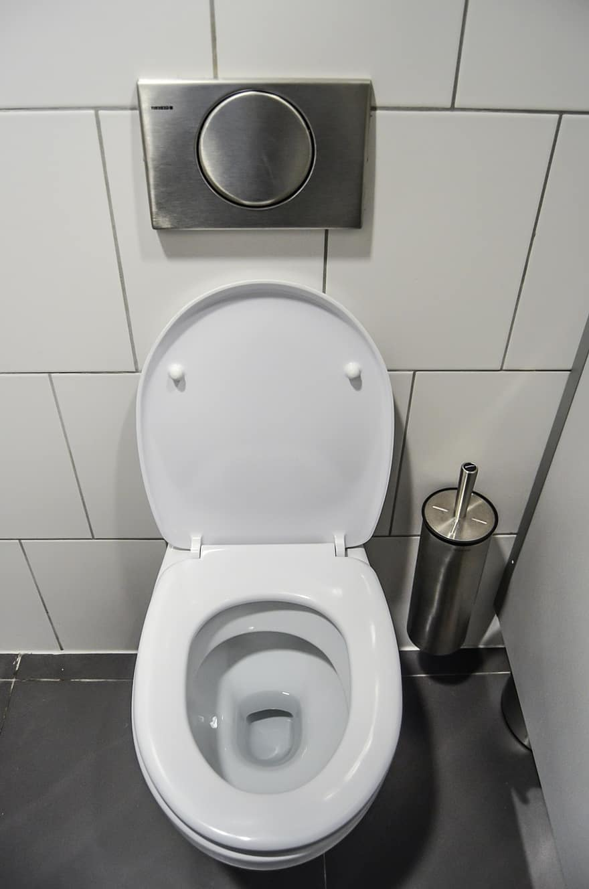

Diabetes was discovered by Demetrius in the first century BC.
The ancient greeks are said to have found out about diabetes by tasting peoples wee!

