Slide 1


Slide 2
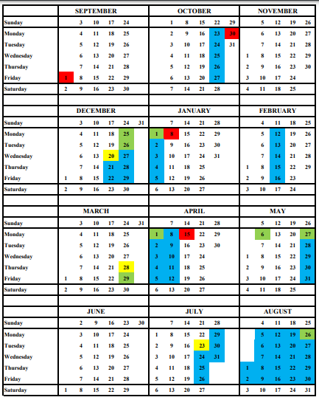
Key Dates:
Year 6 Bikeability 13/14/18/19 September
Year 6/7 transition events:
21 September - Open Evening
26 and 28 September - Open Mornings
9 November - Transition Day 1
18 April - Transition Day 2
27 June - Transition Day 3 and Induction Evening for Parents

Slide 3

https://www.st-petersoxon.co.uk/willow-class-years-5-6-2/

Slide 4
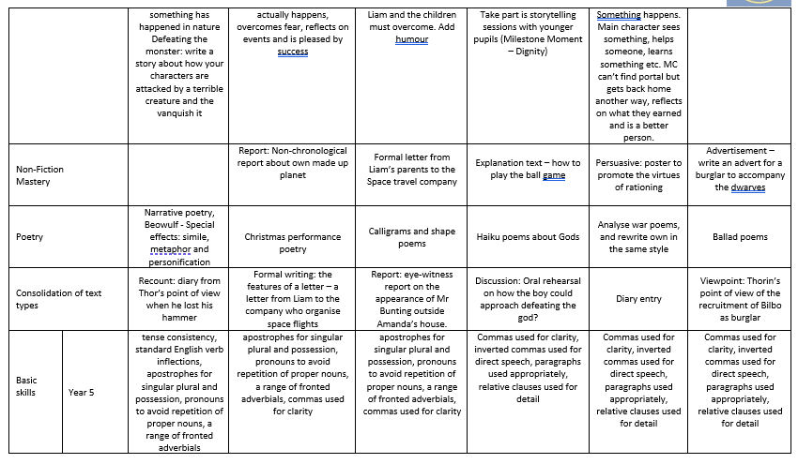

Slide 5
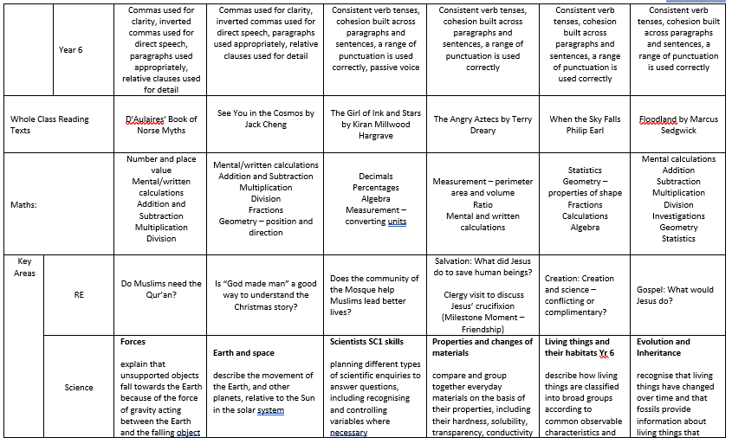

Slide 6
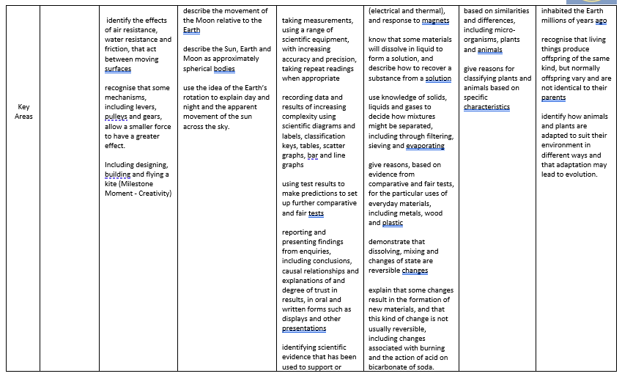

Slide 7
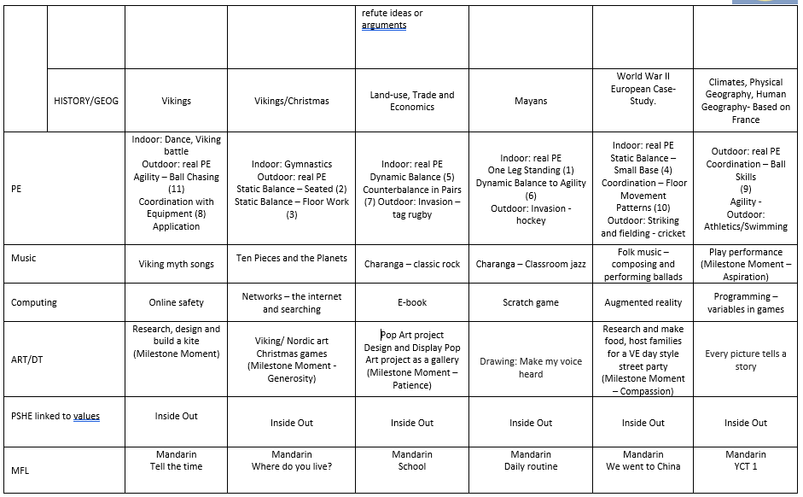


Slide 8

PE will take place on Wednesday and Friday afternoons, we ask that the children have their PE kit in all week and take it home over the weekend for washing.

Slide 9

Homework will be given out on a Friday and should be returned the following Wednesday.
It will consist of maths (related to that week’s work), spellings and reading.
Children will receive 2 house points for completed maths, 2 house points for completed spelling sheets and house points for reading are given as follows:
10 pages – 1 hp
20 pages – 3 hp
50 pages or more – 7hp
https://www.st-petersoxon.co.uk/maths/

