Slide 1
Oak Class
Curriculum Meeting
Thursday 8th September 2022

Slide 2
Oak Class
Mrs Bradley teaches Monday – Wednesday
Mrs Carter teaches Thursdays and Fridays
Mrs Cook and Mrs Jennings support Oak Class each day.

Slide 3

Whole Year Overview

Slide 4
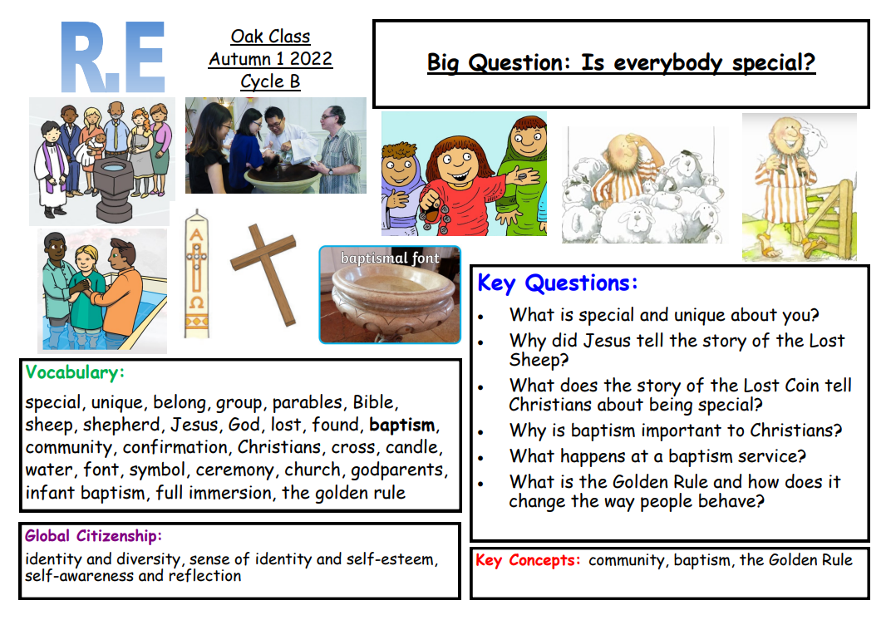
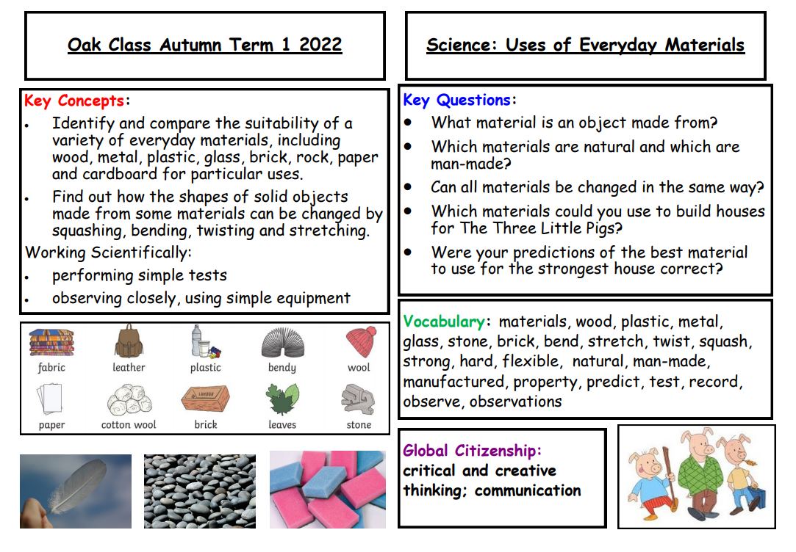
Topics for this term:
The Great Fire of London

Slide 5
Timings of the day
8:30am Morning tasks
8:40 Door will close and register is taken
8:40 – 10:00 Maths
10:00 – 10:20 Collective Worship
10:20 – 10:40 Morning break
10:40 – 11:40 RWI (Phonics and Reading)
11:40 – 12:00 Maths Fluency
12:00 – 1:00 Lunch time
1:00 – 2:00 Afternoon lesson 1
2:00 – 3:00 Afternoon lesson 2
3:00 – 3:10 Story time
3:10pm Home time!

Slide 6
Spellings
Mrs Bradley’s groups:
Given out on a Wednesday.
Tested on the following Tuesday
Mrs Carter’s groups:
Given out on a Friday.
Tested on the following Thursday.

Slide 7
P.E
Friday afternoon in the hall.
Black/navy shorts and plain white t-shirt needed.
No jewelry to be worn.
RealPE: coordination of footwork and static balances

Slide 8
Forest School
Monday afternoons with Mrs Edwards
The children need to have waterproofs (waterproof trousers and coat or an all-in-one) to put over top of their school uniform and wellies for every Forest School session. If the weather is cold, they will need hat, gloves and an extra jumper. If the weather is hot, they are still required to have their arms and legs covered so a long-sleeved T-Shirt to go with their school trousers and a sun hat. Wellies are always required!

Slide 9
Things to bring to school
Book bag with reading book and reading record book everyday
Water bottle - named
Waterproof coat
Wellies/trainers for break times
Hat for the sunny days
PE kit and Forest School kit
Spare change of clothes to be left on pegs
Absolutely everything named!

Slide 10
How we learn in Oak Class
Focus on ‘what we are learning’ not ‘what we are doing’.
Learning objective taken from National Curriculum (Locally agreed syllabus for R.E)
3 I can statements
Challenge questions (Maths/English)
Deepening our learning (R.E)
New Understanding Christianity scheme for some RE units
New focus on Mastery in Maths
Daily RWI lesson to teach Phonics and Reading
Some opportunities for learning in the outside area (fine motor skills; language and communication)

Slide 11
Expectations
Smart school uniform
Best behaviour – following our school behaviour policy
Home School Agreement

Slide 12
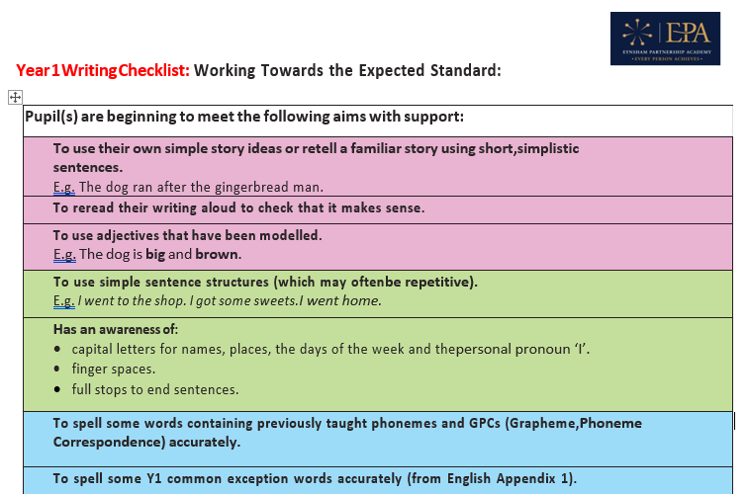
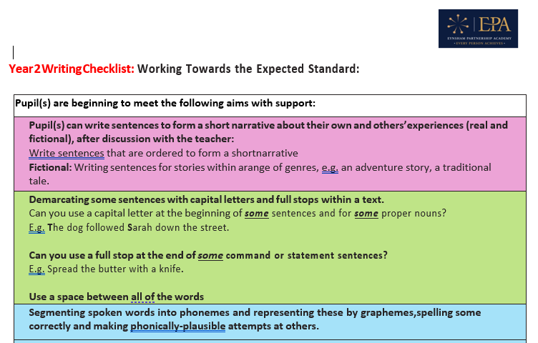
Expectations for writing in Y1 and Y2
See the documents on the Oak Class webpage
Pink: composition
Green: grammar and punctuation
Blue: transcription

Slide 13
Statutory Assessments
Phonics Screening
- Year 1 children in June 2023
Year 2 SATs in May 2023
2 reading papers
2 SPAG papers (1 spelling; 1 punctuation and grammar)
2 Maths papers (arithmetic and reasoning)
Writing is a teacher assessed judgment
Nothing to worry about!

Slide 14
Things to practise at home
Times tables (x2, x5, x10)
Spelling common exception words (see the list on the Oak Class webpage)
Y1 - fine motor skills – cutting out, sticking, threading beads onto string, using tweezers to pick things up, play finger football with cotton wool balls
Year 2 – cursive handwriting, starting on the line
Year 2 – encourage them to get into the habit of spotting and correcting their own mistakes

Slide 15
Reading, reading, reading!
As often as possible but at least 3 times a week.
Record pages read in the reading record book.
Use the bookmarks for questioning prompts.
Books that come home will match your child’s phonic ability and will be linked to their RWI lessons.
Opportunities for the children to hear stories being read expands their vocabulary.
When children need a new reading book, they need to put their book bag in the big plastic box in the cloakroom.

Slide 16
Parents’ Evenings
Wednesday 19th and Thursday 20th October 2022
Wednesday 19th April and Thursday 29th April 2023
Nativity
Wednesday 14th December 1:30pm
Thursday 15th December 6:00pm

Slide 17

Oak Class Webpage
Website links which you might find useful
https://www.st-petersoxon.co.uk/oak-class-years-1-2-2/
Keep an eye on the class page.

Slide 18
Any questions or concerns?
Please just ask.
We’re always happy to chat!

