Slide 2
Why do we have our vision and values?
Where did St Peter fish? (Sea of….)
Imagine you are St Peter on your boat
Ripples in a water tray
What effect can you have?
Boat – help/hinder
You are either a part of the solution of part of the problem

Slide 3
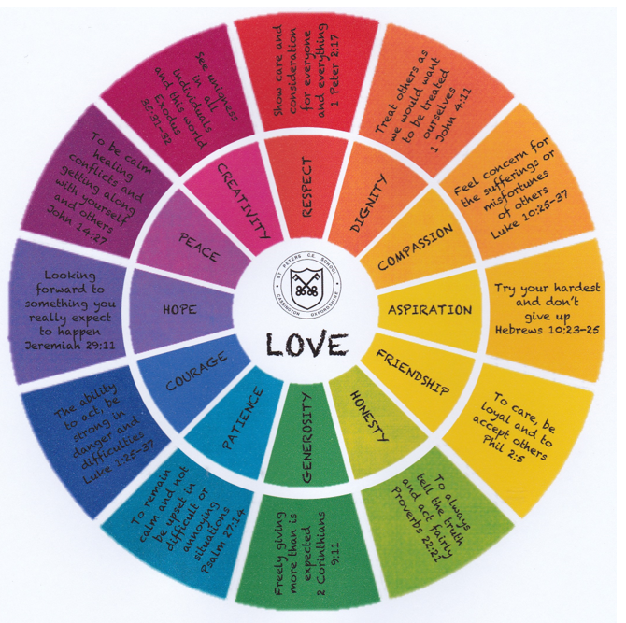
What would the world be like if…..
Watch this video
Which value are staff not showing?
What kind of ripple did Mr Jeffries start?

Slide 4

What would the world be like if…..
Watch this video
Which value are staff not showing?
What kind of ripple did Mr Jeffries start?

Slide 5
What would the world be like if…..
What happened to everyone’s lives when Mr Jeffries started a positive ripple?

Slide 6
At St Peter’s….
We believe that through living our vision and values in our daily lives, we send positive ripples of love which have a lasting impact on the world; a BIG gift, from a small school.

Slide 7
Your turn!
Get into a team of 6 (ish) – 2 Willow, 2 Maple and 2 Oak
Pick a value
Show how you can create a positive ripple

