Slide 1

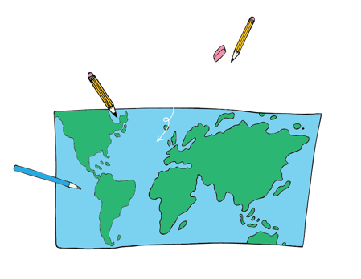




World Watch List Quiz
Have your
World Watch List Children’s Map
ready!

Slide 2


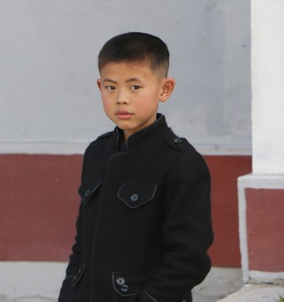
1. Which country is this?
FASCINATING FACT
In this country, the leader and his family are worshipped
like gods.

Slide 3
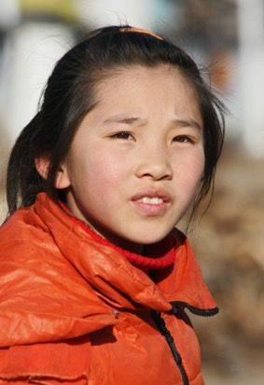

2. Which country is this?
FASCINATING FACT
This huge nation shares its borders with 16 other countries!

Slide 4
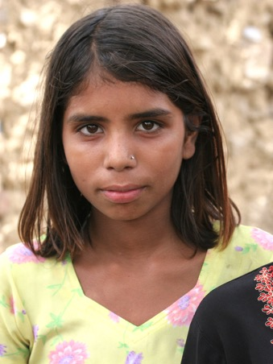

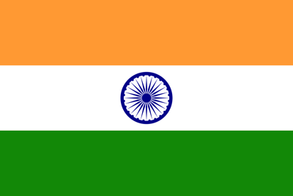
3. Which country is this?
FASCINATING FACT
This country has the second largest population in the world.

Slide 5
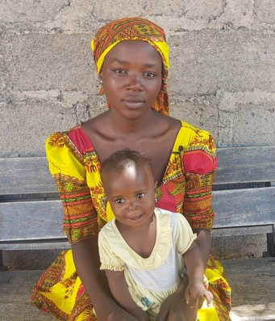


4. Which country is this?
FASCINATING FACT
This country has the highest score for violence against Christians.

Slide 6
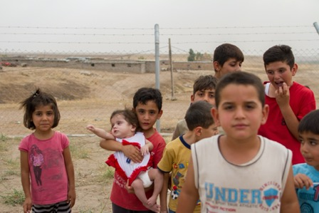

5. Which country is this?
FASCINATING FACT
1.25 million Christians have fled this country in the last 20 years.

Slide 7

6. Which country is this?
FASCINATING FACT
After Egypt, this country has the highest number of archaeological discoveries in Africa.

Slide 8

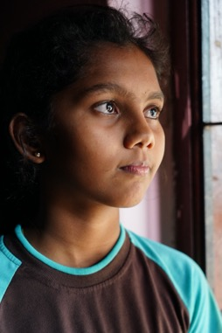

7. Which country is this?
FASCINATING FACT
The main religion in this country is Buddhism.

Slide 9
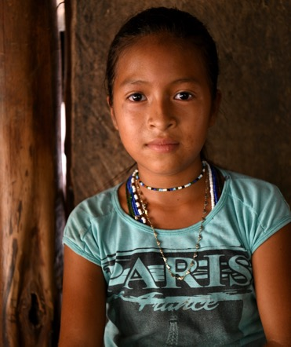

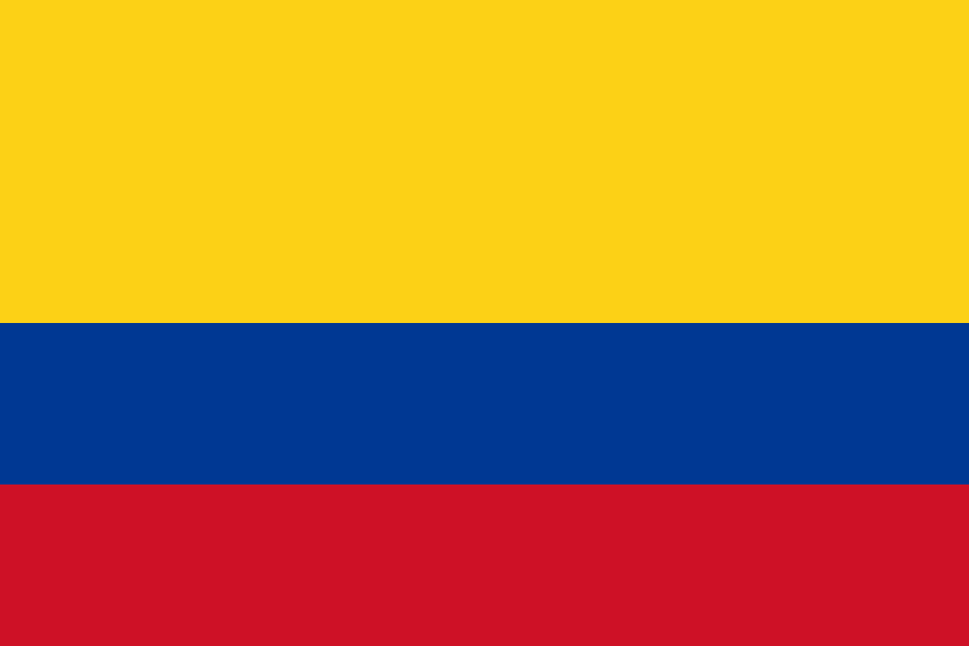
8. Which country is this?
FASCINATING FACT
This country is named after a legendary Italian explorer.

Slide 10
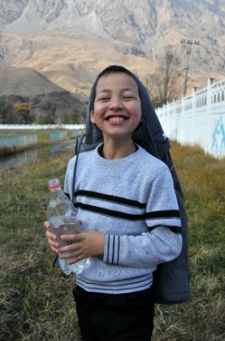
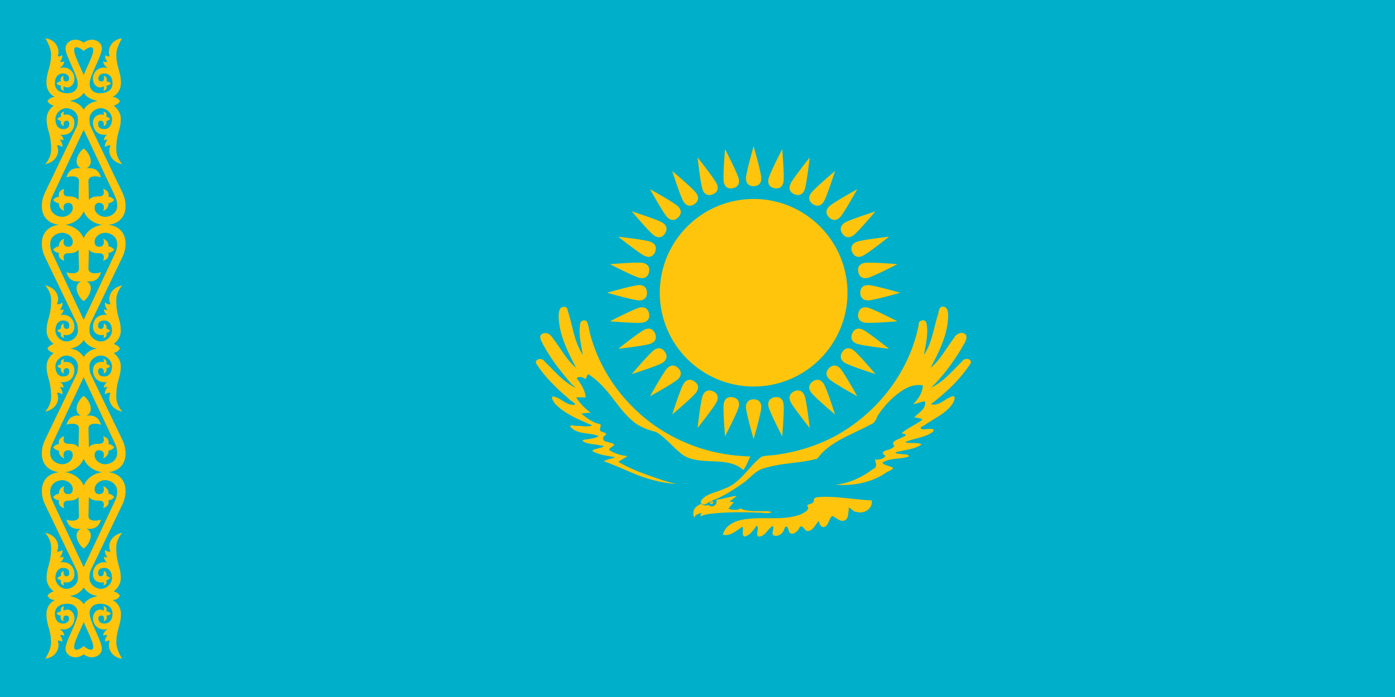
9. Which country is this?
FASCINATING FACT
This is the largest landlocked country in the world – but has a navy on the Caspian Sea.

Slide 11
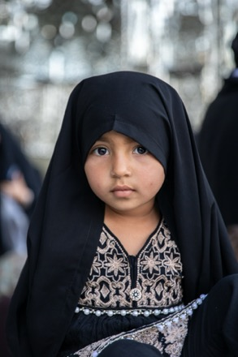

10. Which country is this?
FASCINATING FACT
This country used to be known as Persia.

Slide 12
Answers
1. NORTH KOREA
2. CHINA
3. INDIA
4. NIGERIA
5. IRAQ
These are all countries where Christians are persecuted.
You can find out how serious the danger is by looking at how they are ranked on the Open Doors World Watch List.
6. ERITREA
7. SRI LANKA
8. COLOMBIA
9. KAZAKHSTAN
10. IRAN

Slide 13

Use the World Watch List Map to help you pray for persecuted children around the world.
You can send messages
of encouragement, too.
To find out how, order Post It! from
www.opendoorsuk.org

