Slide 1

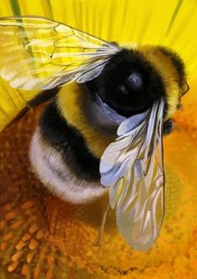
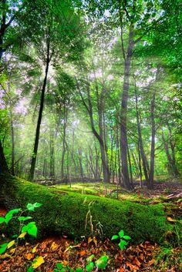
St Peter’s Eco Group Assembly
Eco Student Leadership Team
Ellie, Megan & Eliza
Vicky Thomas Clarke – Adult leader
Notes:
NOTE: To change images on this slide, select a picture and delete it. Then click the Insert Picture icon
in the placeholder to insert your own image.

Slide 2

Story
Greta and the Giants
by
Zoë Tucker (Author)
Zoe Persico (Illustrator)
Notes:
NOTE: To change images on this slide, select a picture and delete it. Then click the Insert Picture icon
in the placeholder to insert your own image.

Slide 3
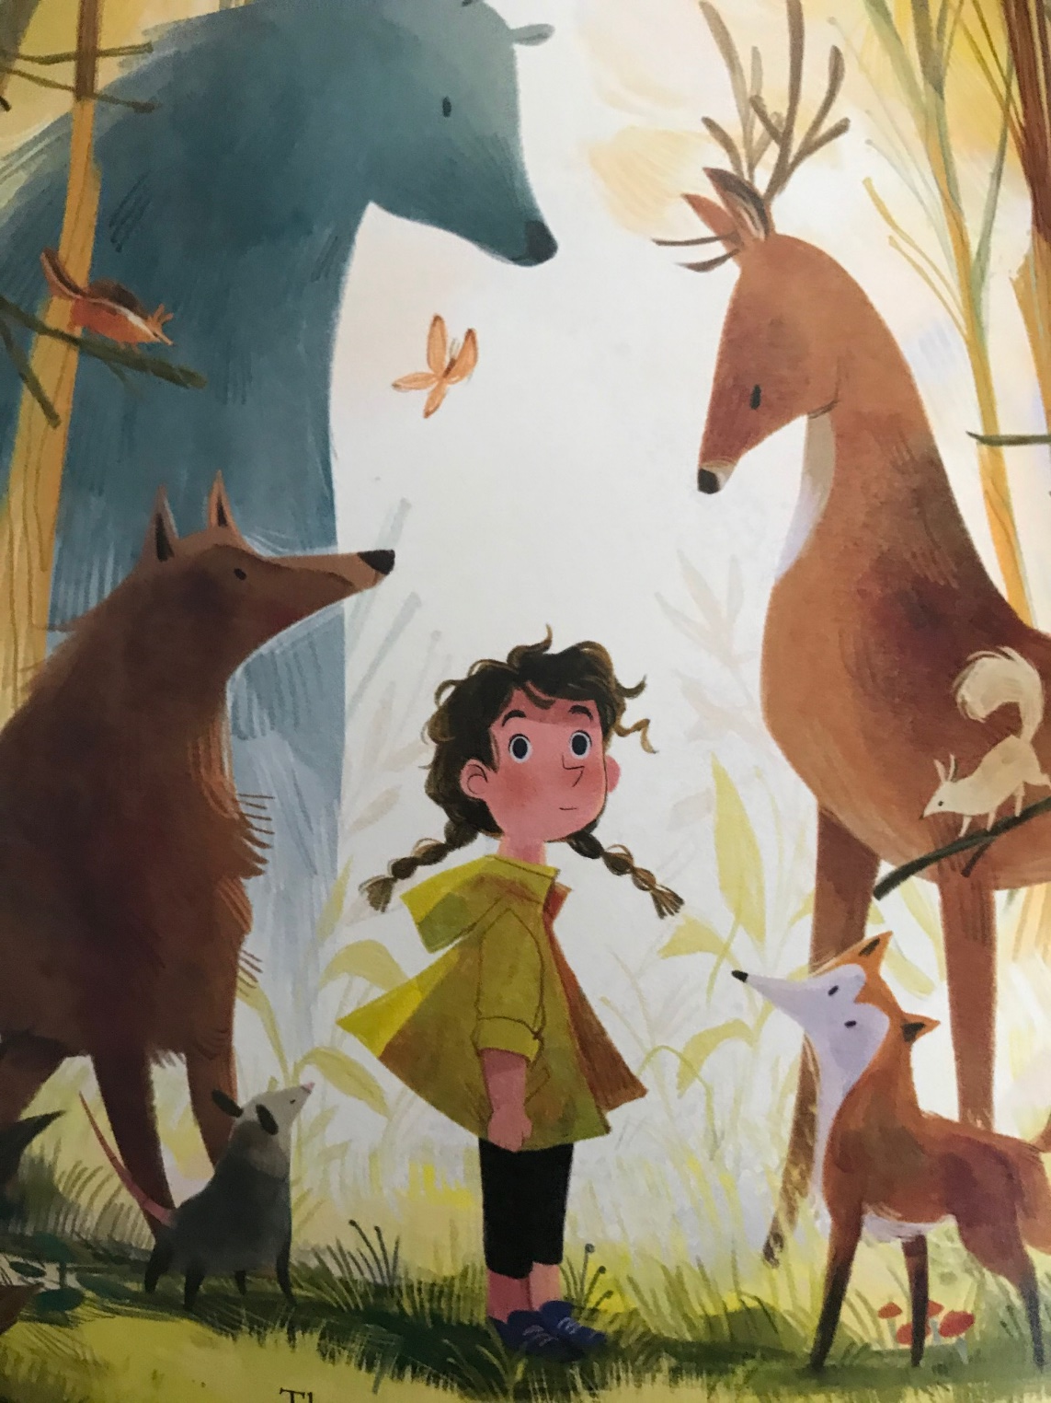
There was once a girl who lived at the heart of a beautiful forest.
Her name was Greta.

Slide 4
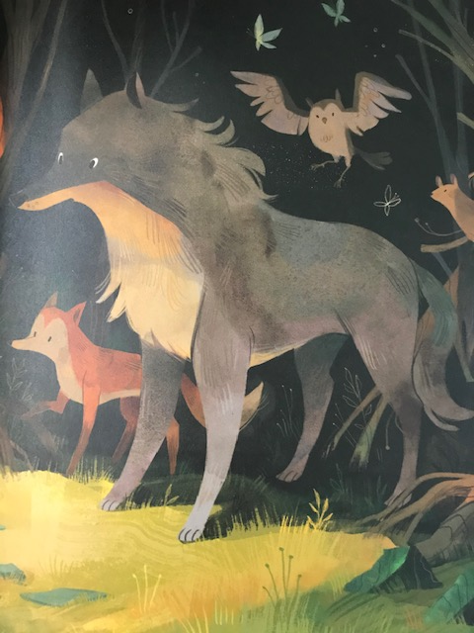
“The forest is broken and we don’t know where to go.
The Giants are ruining our home. ”

Slide 5
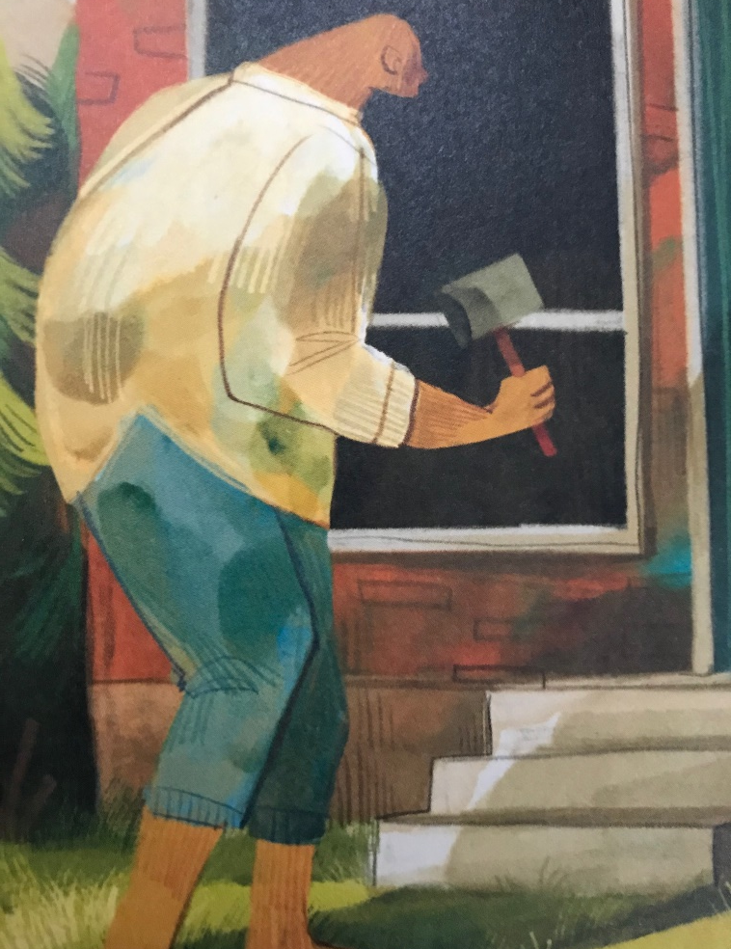
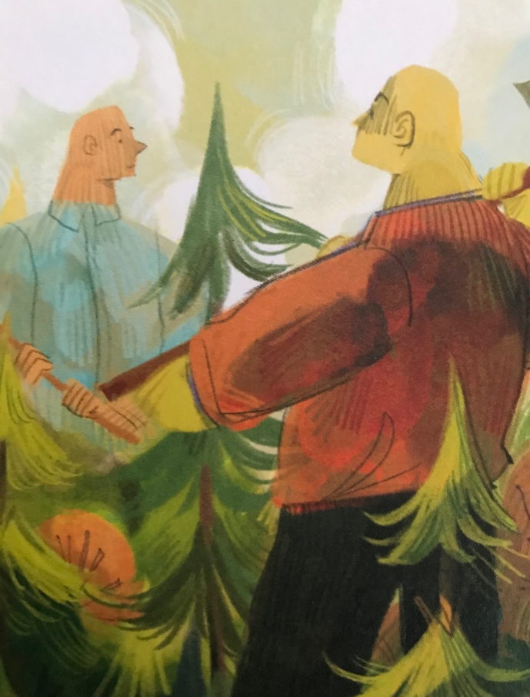
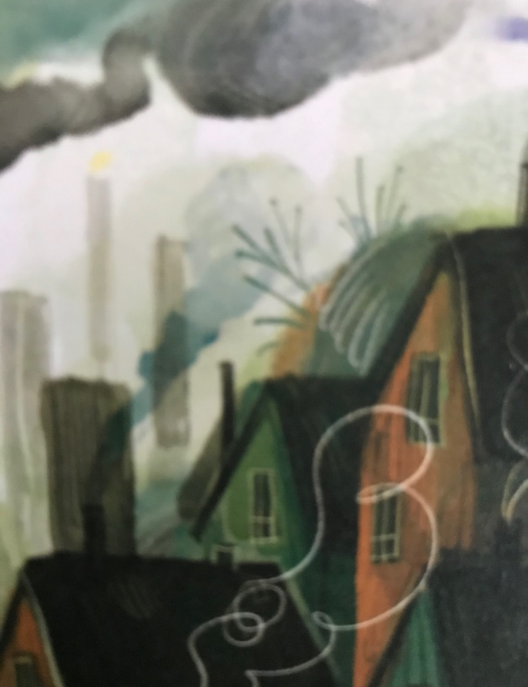
They chopped down trees to build houses. The houses grow into towns and towns into cities.
Notes:
NOTE: To change images on this slide, select a picture and delete it. Then click the Insert Picture icon
in the placeholder to insert your own image.

Slide 6
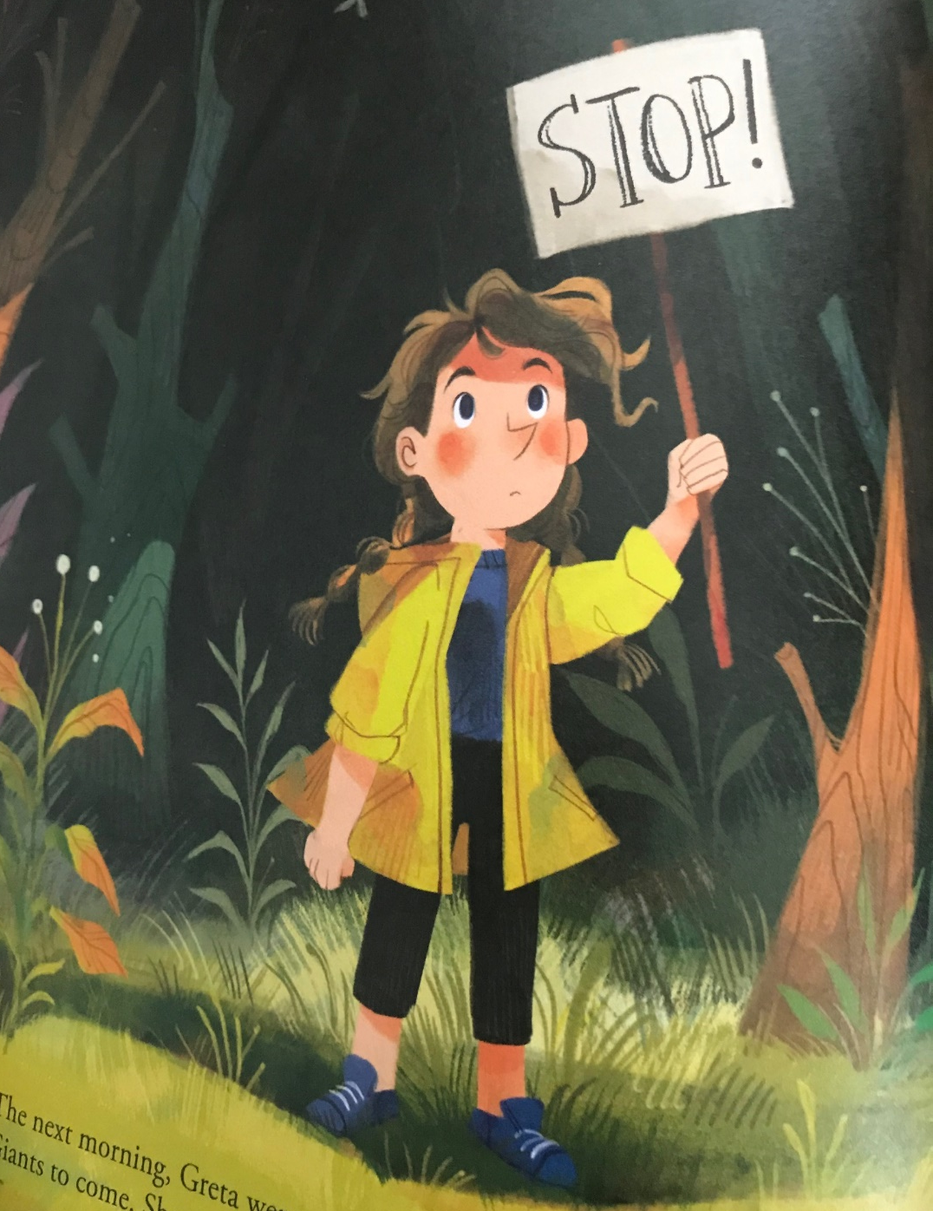
She stood alone, holding a big sign.
The sign said STOP!
She waited…
and waited..

Slide 7
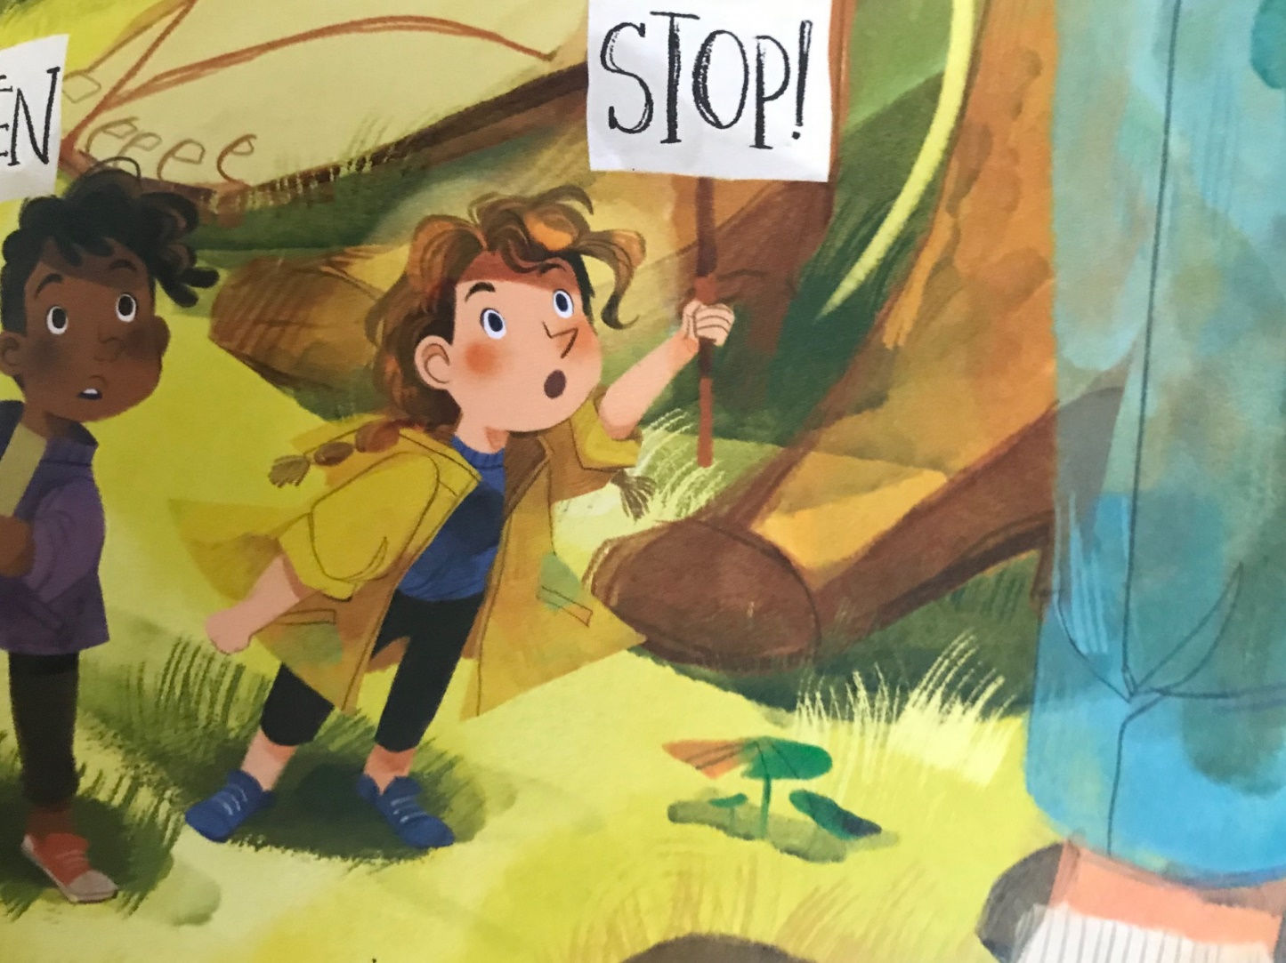
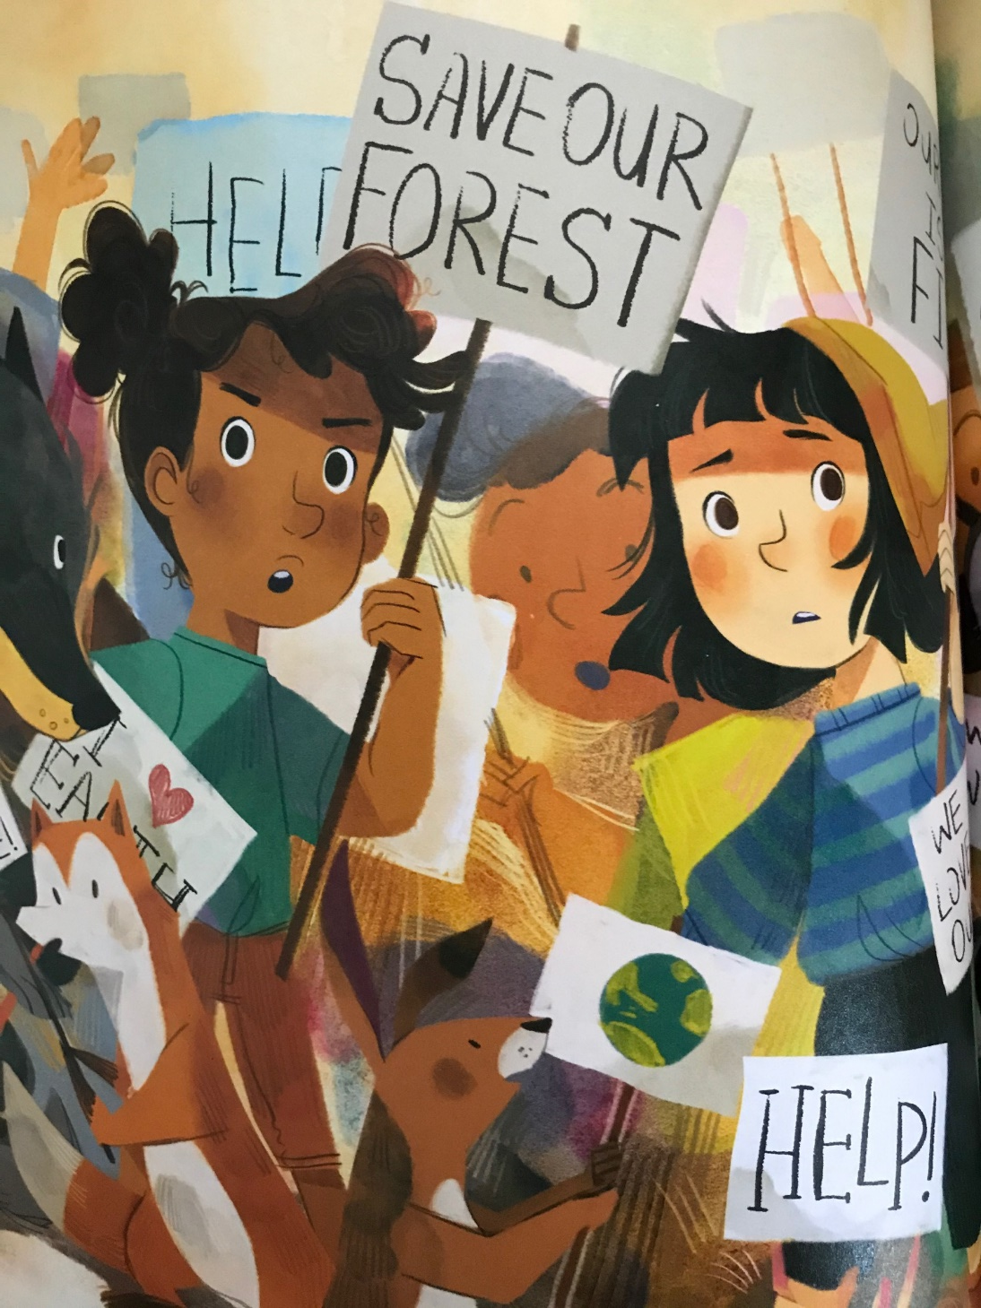
“Please STOP!”

Slide 8
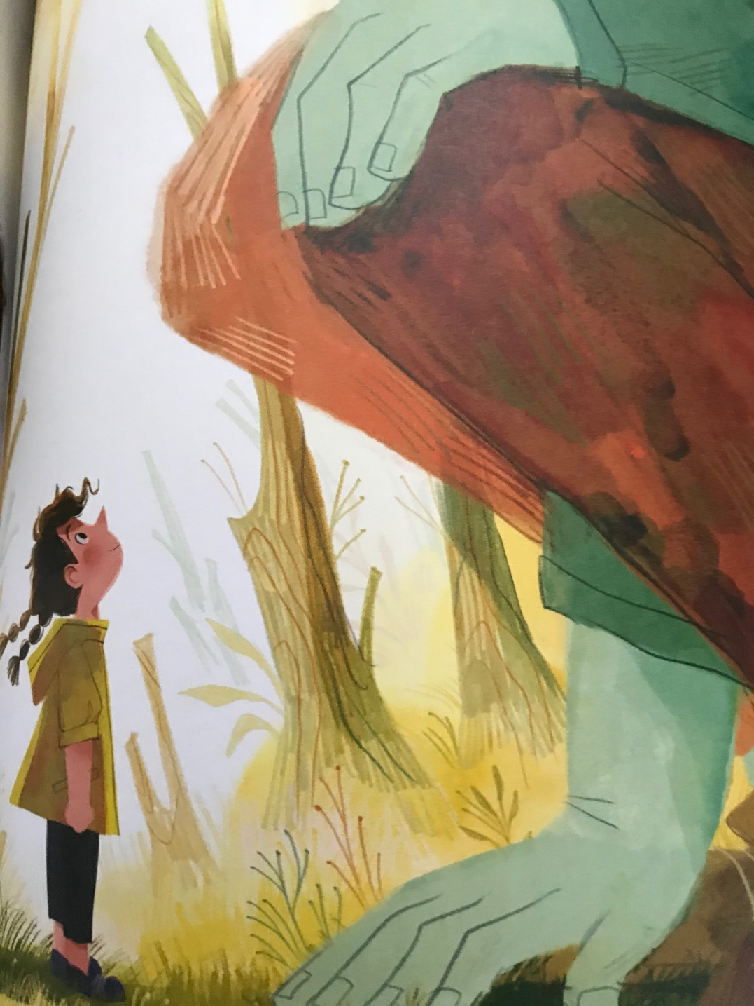
The Giants felt terrible.
“We’re sorry,” they said
And they promised to try harder

Slide 9
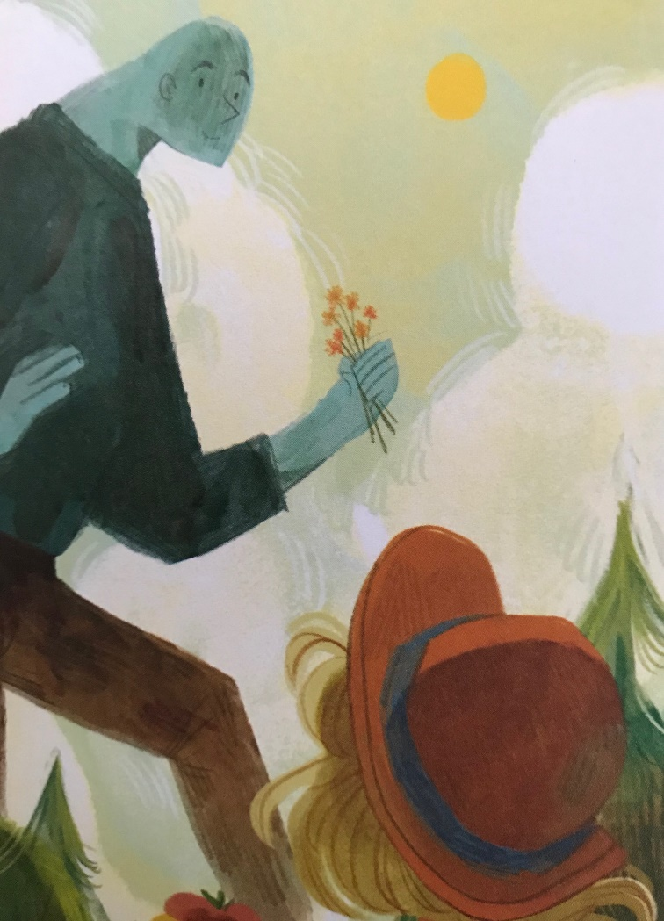
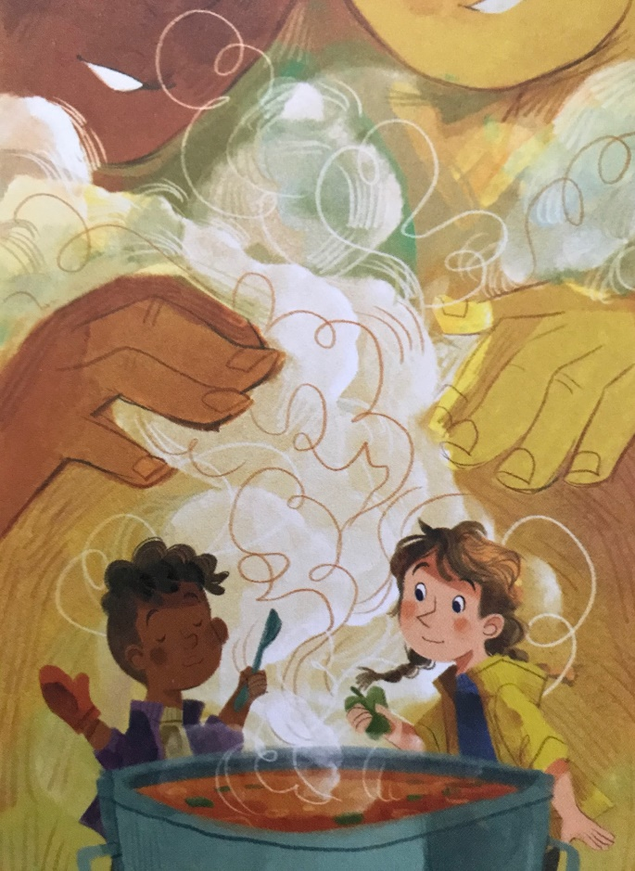
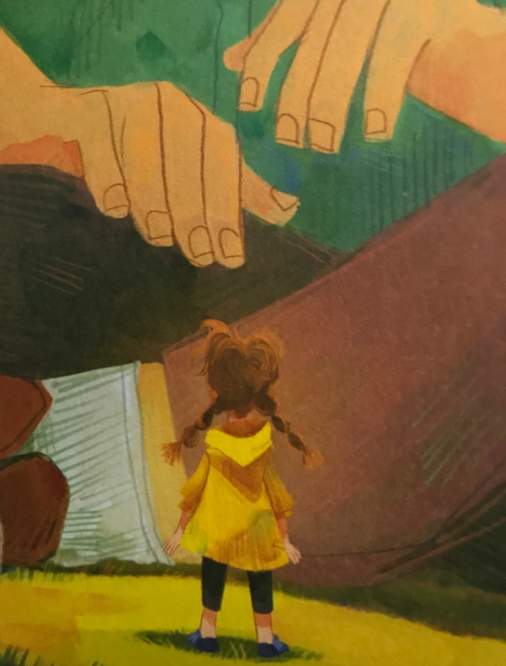
They slowed down, they took up new hobbies, they stopped cutting down trees, they cooked, repaired, tidied and shared.
Notes:
NOTE: To change images on this slide, select a picture and delete it. Then click the Insert Picture icon
in the placeholder to insert your own image.

Slide 10
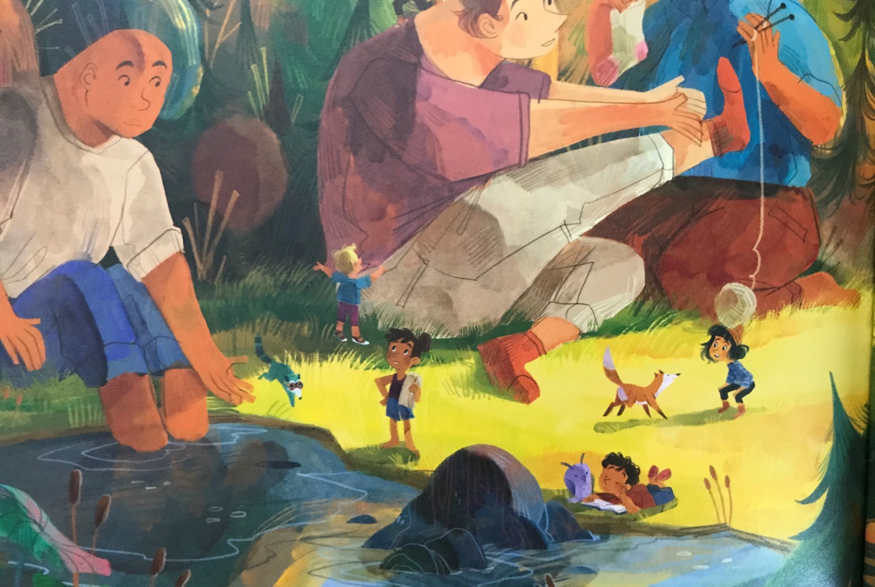
And before long the forest became more beautiful than they ever could imagined.
Notes:
NOTE: To change images on this slide, select a picture and delete it. Then click the Insert Picture icon
in the placeholder to insert your own image.

Slide 11
How can we all help?

Slide 12
RECYCLE

Slide 13
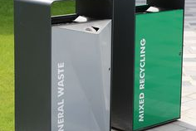
Recycle plastic, paper, tins & glass
Notes:
NOTE: To change images on this slide, select a picture and delete it. Then click the Insert Picture icon
in the placeholder to insert your own image.

Slide 14

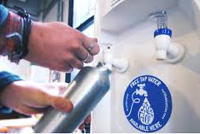
Use & carry refill water bottles
Notes:
NOTE: To change images on this slide, select a picture and delete it. Then click the Insert Picture icon
in the placeholder to insert your own image.

Slide 15

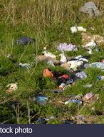
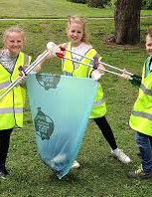
Do not litter and pick up rubbish
Notes:
NOTE: To change images on this slide, select a picture and delete it. Then click the Insert Picture icon
in the placeholder to insert your own image.

Slide 16
REUSE

Slide 17


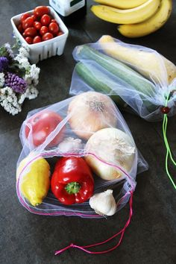


Use & carry reuseable shopping bags
Notes:
NOTE: To change images on this slide, select a picture and delete it. Then click the Insert Picture icon
in the placeholder to insert your own image.

Slide 18
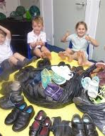


Donate old clothes, shoes & toys
Notes:
NOTE: To change images on this slide, select a picture and delete it. Then click the Insert Picture icon
in the placeholder to insert your own image.

Slide 19
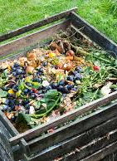
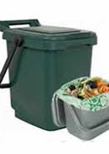
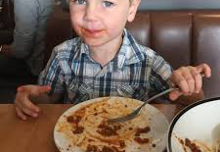
Waste less food & compost food waste
Try creating a garden composter – the worms will love it!
Notes:
NOTE: To change images on this slide, select a picture and delete it. Then click the Insert Picture icon
in the placeholder to insert your own image.

Slide 20
REDUCE

Slide 21
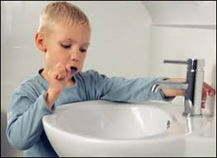
Waste less water
Turn off taps when brushing teeth
Use shower
Less Baths
Notes:
NOTE: To change images on this slide, select a picture and delete it. Then click the Insert Picture icon
in the placeholder to insert your own image.

Slide 22
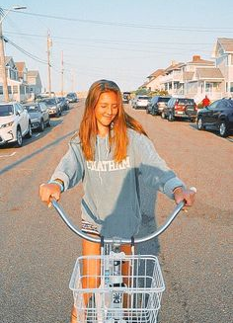
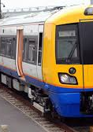
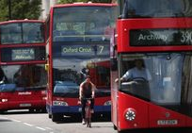
Walk, bike or use public transport – buses & trains
Encourage your parents and family to use the car less and make some fun new journeys together!
Notes:
NOTE: To change images on this slide, select a picture and delete it. Then click the Insert Picture icon
in the placeholder to insert your own image.

Slide 23
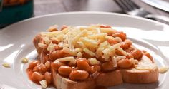
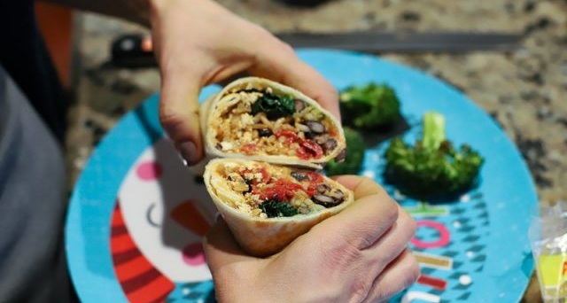

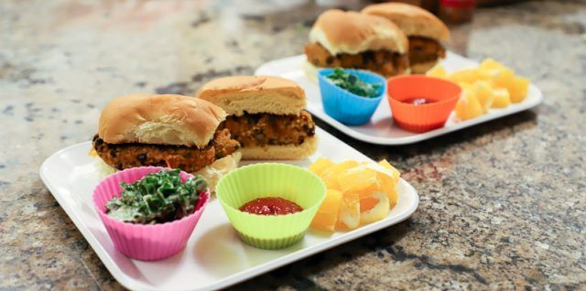
Eat less meat and more plant based meals

Slide 24
CONNECT

Slide 25

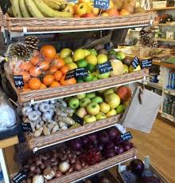
Shop local & learn about seasonal products

Slide 26
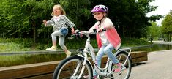
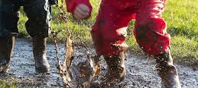
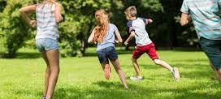
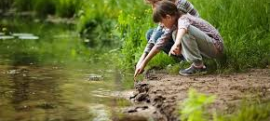
Get outside in nature

Slide 27


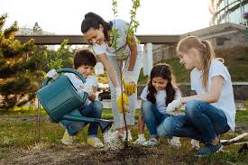
Lead by example and inspire others
Put up your Eco wheel at home and challenge others to take up a new weekly task!
Notes:
NOTE: To change images on this slide, select a picture and delete it. Then click the Insert Picture icon
in the placeholder to insert your own image.

Slide 28
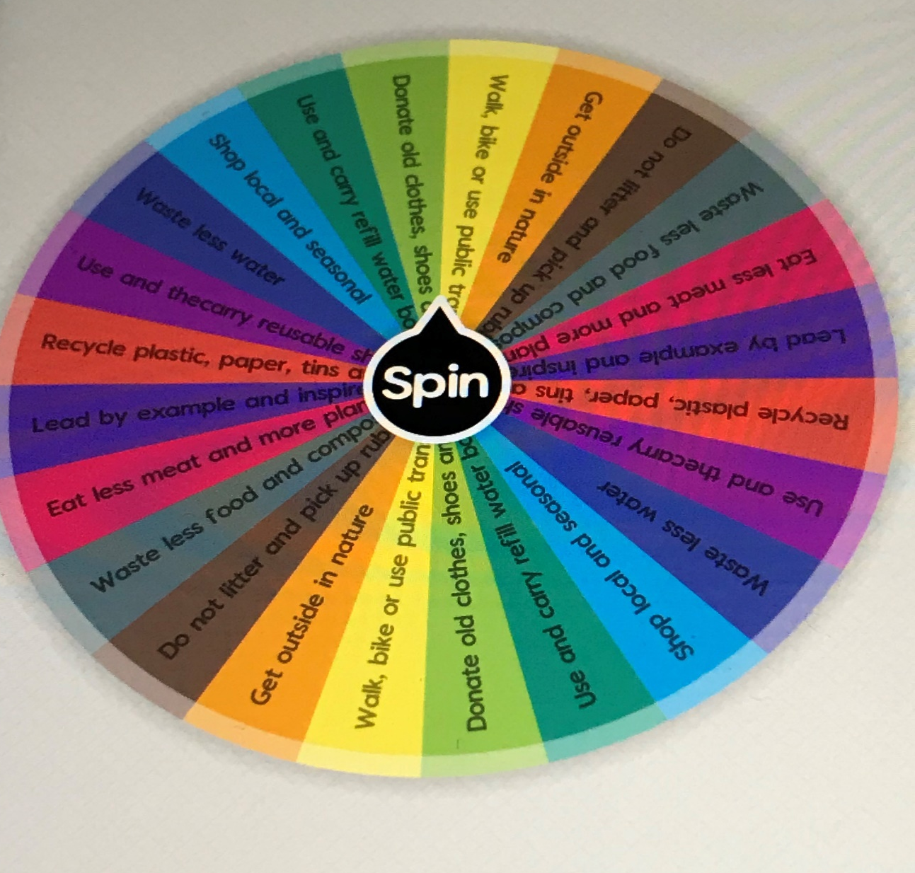
ECO GROUP – let’s spin the wheel…
RECYCLE
REDUCE
REUSE
CONNECT

