Slide 1
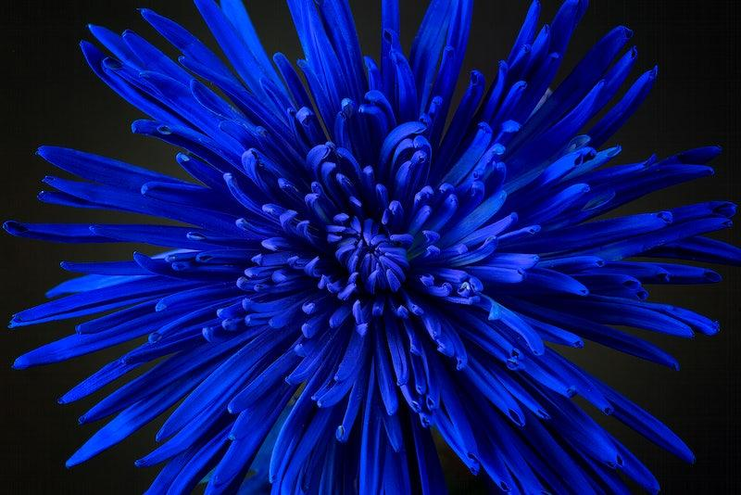
The pond group

Slide 2
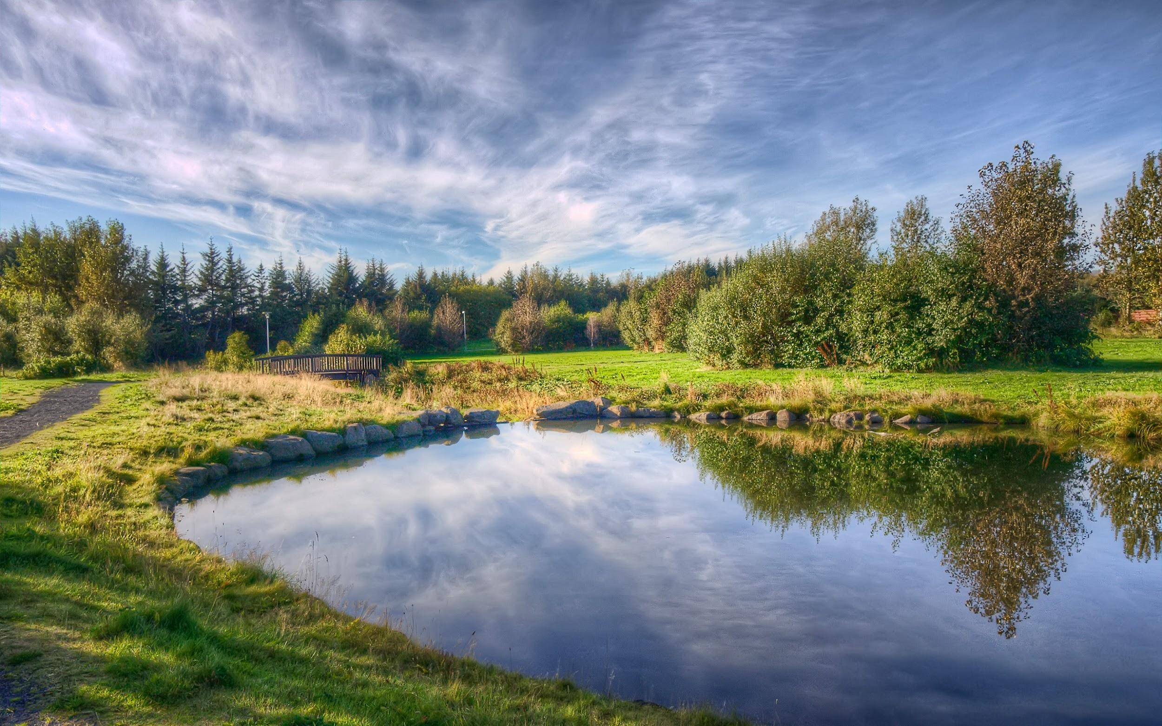
What we’ll be doing this year

Slide 3
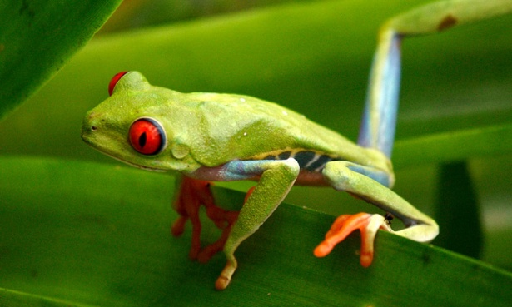
This year we are focusing on monitoring pond wildlife and studying animal behavior.

Slide 4
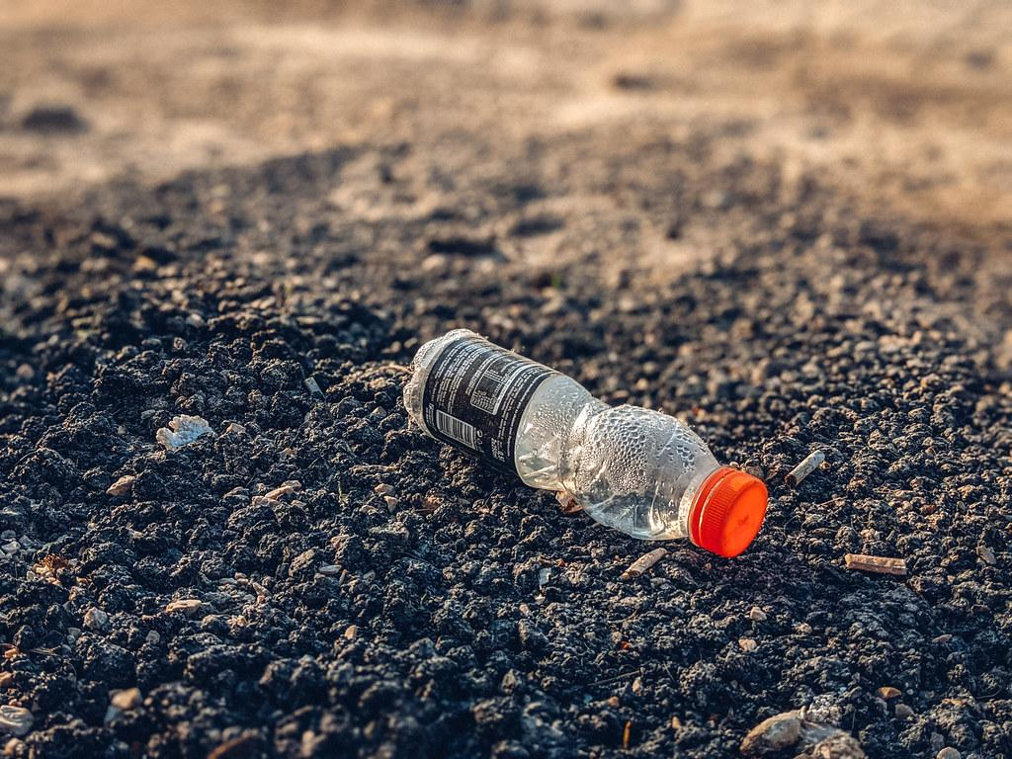
We also want to focus a lot on litter-picking because litter can have a real impact on animal’ s health and can end up in the ocean.

Slide 5
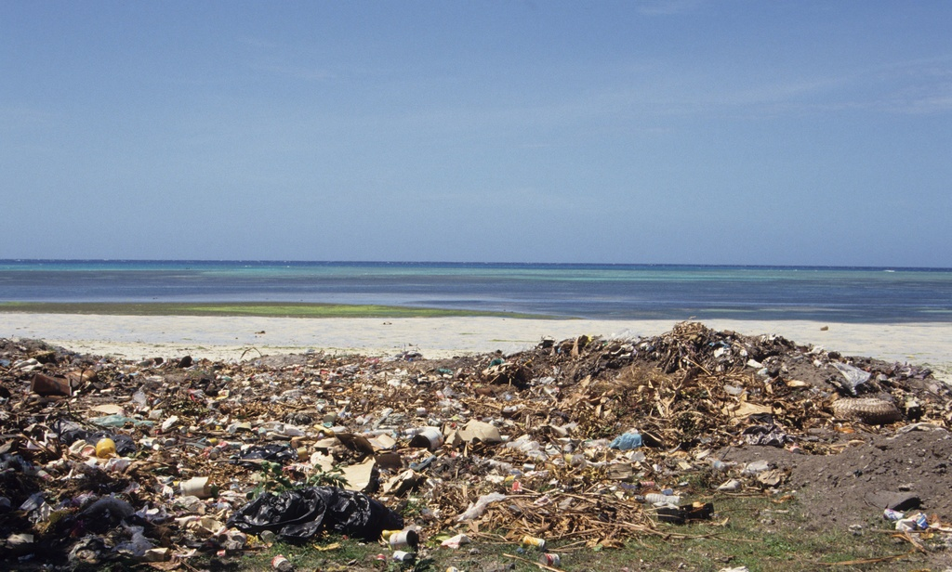
Litter in the sea
When litter gets in the sea, animals can eat it and can die from poisons in plastics and they can also sometimes get stuck in litter.This makes lots of people very sad, so if you could help with litter picking that would be great!!!!!!!!!!

Slide 6

To help, we will be picking up litter and making posters to show people not to litter.Litter can pollute the sea very easily, so we encourage you to litter pick only for a little bit every time you go to the beach!!!!!!!!!

Slide 7
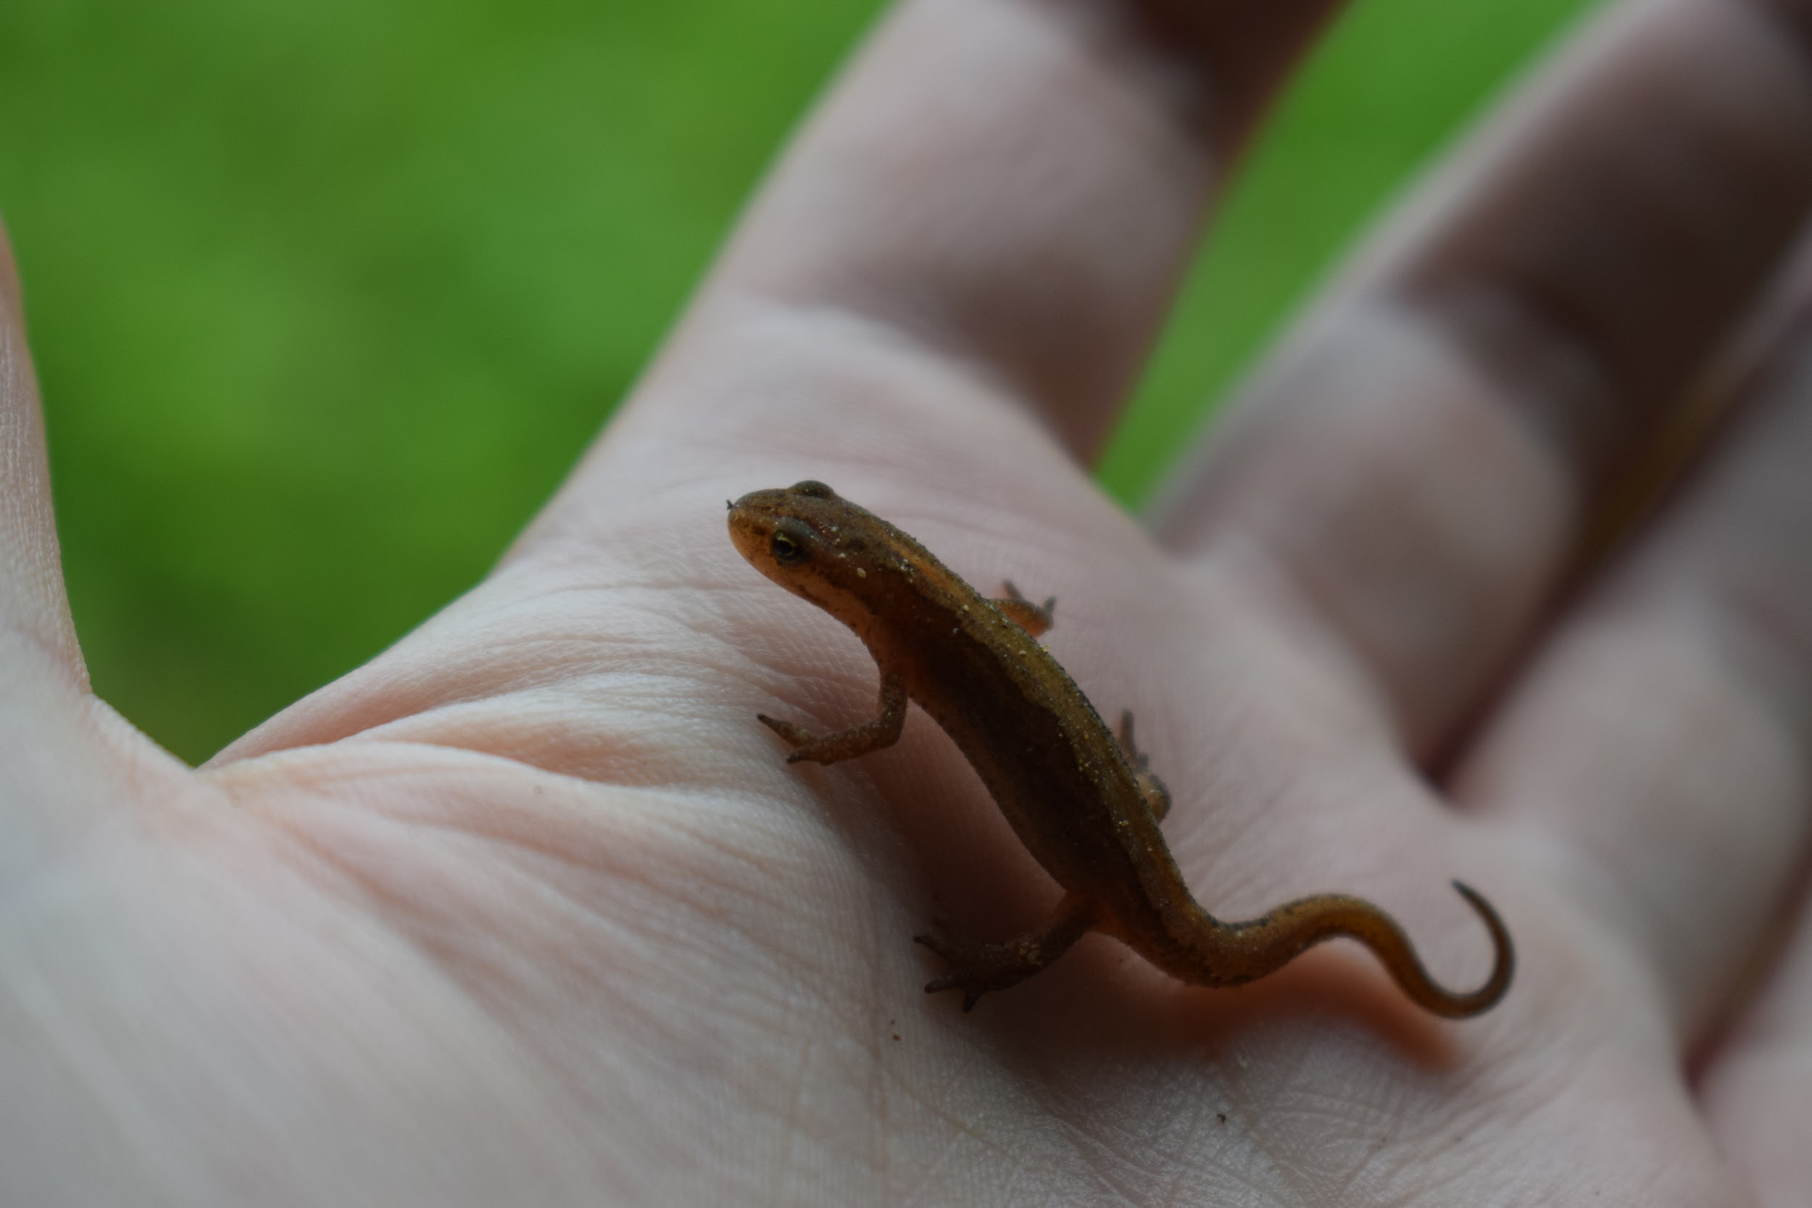
To help save the environment and animals you can go out on litter picking trips and donate money to charities that help the environment.

Slide 8
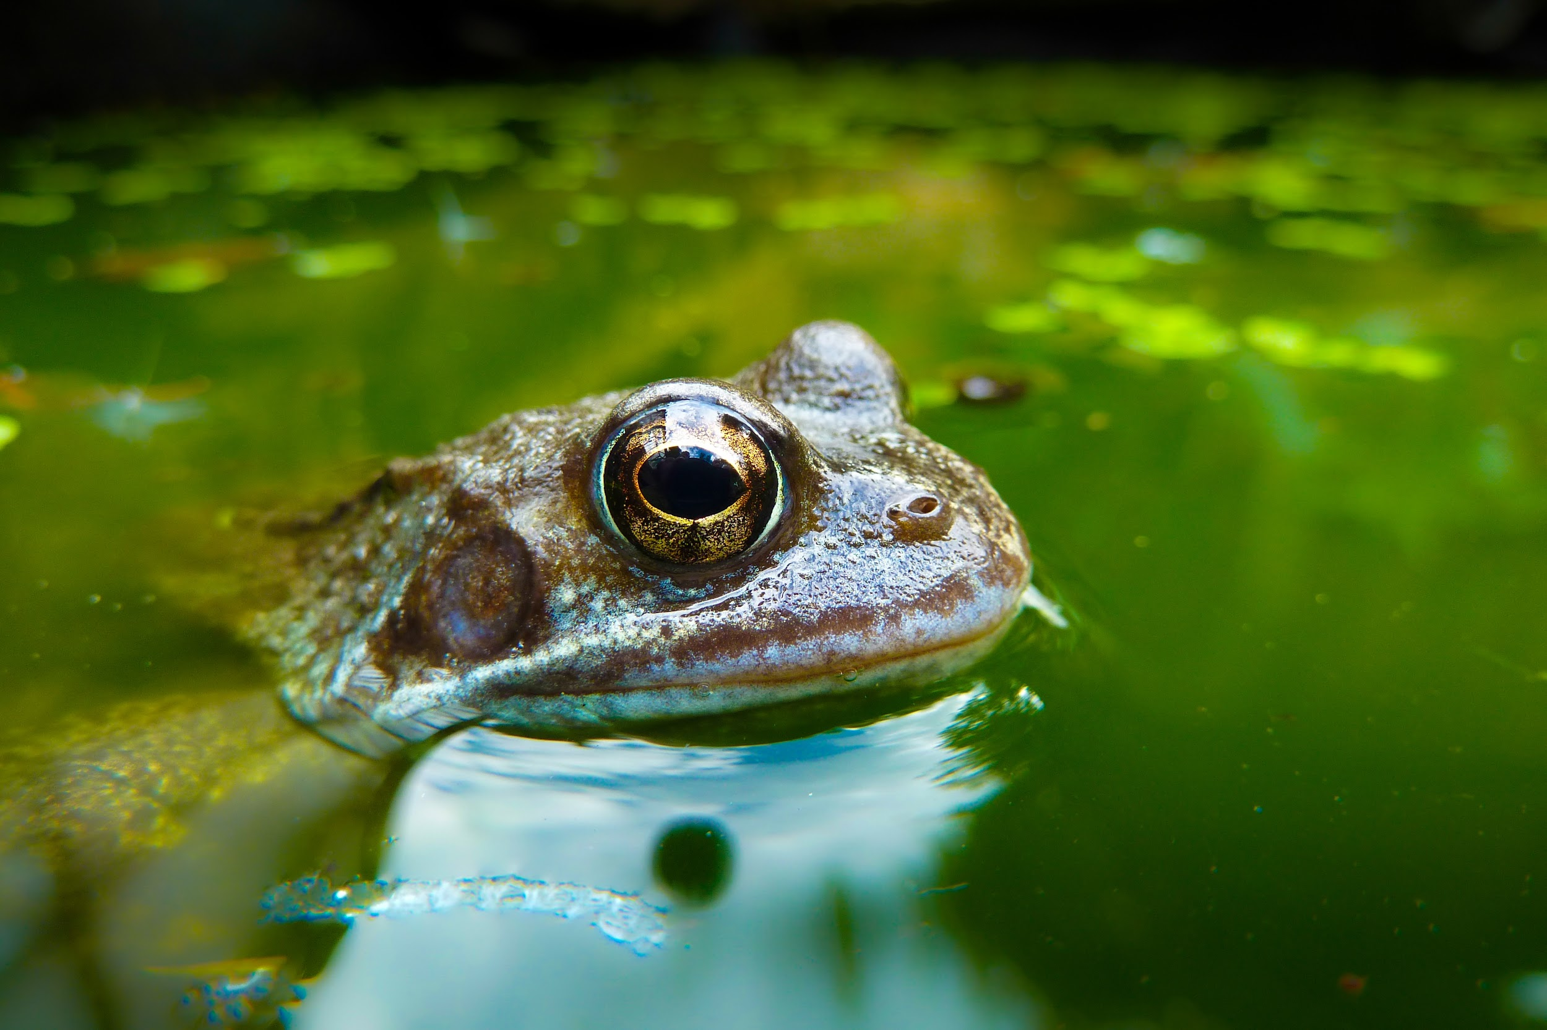
Animal behavior!
We have a camera to monitor wildlife and we are putting out birdseed.We also have a toad home and spots for insects to hide in.We have also put down big sheets of metal and are hoping to see some sloworms..

Slide 9
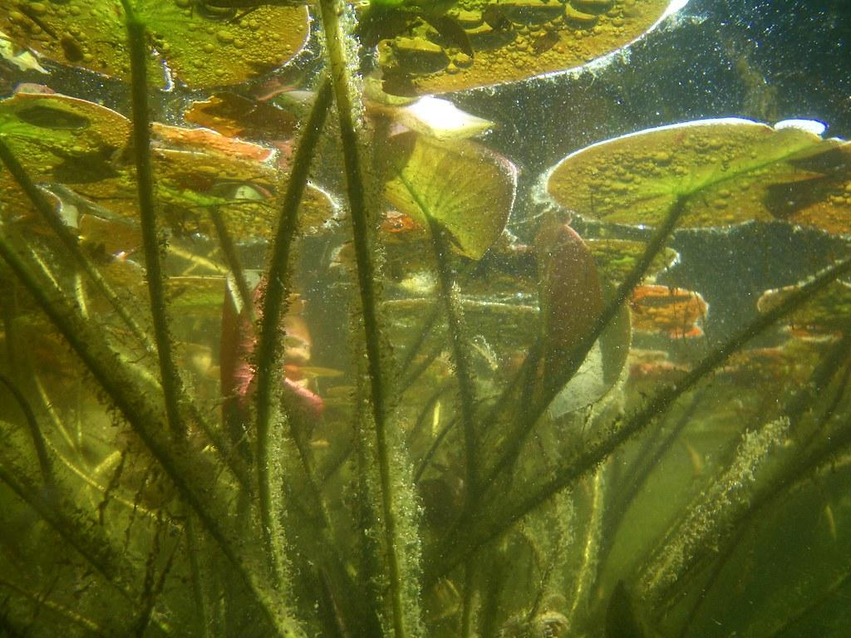
If we do see any of these animals we will try to get photos and then we will show you so you get to see some of the amazing wildlife that we get to see in the pond.like this….

Slide 10
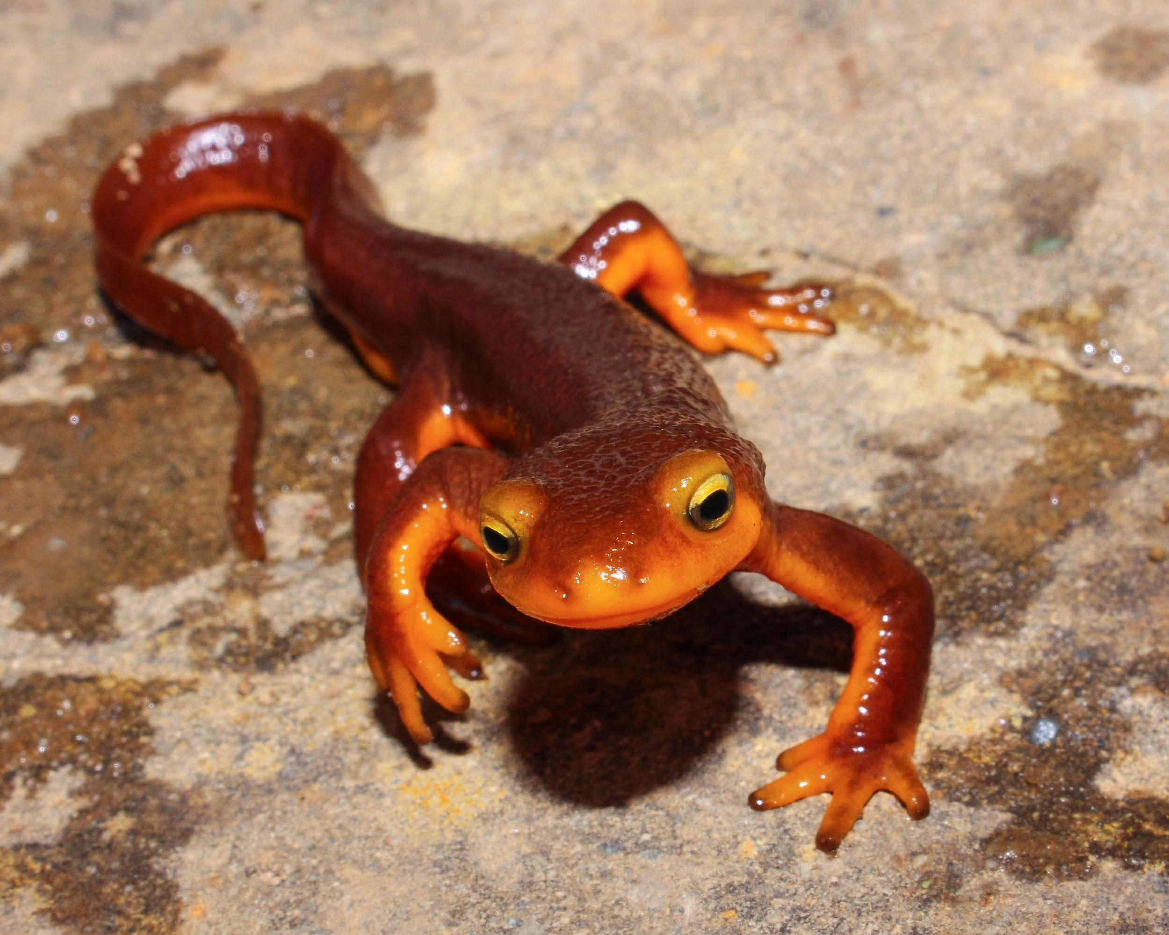
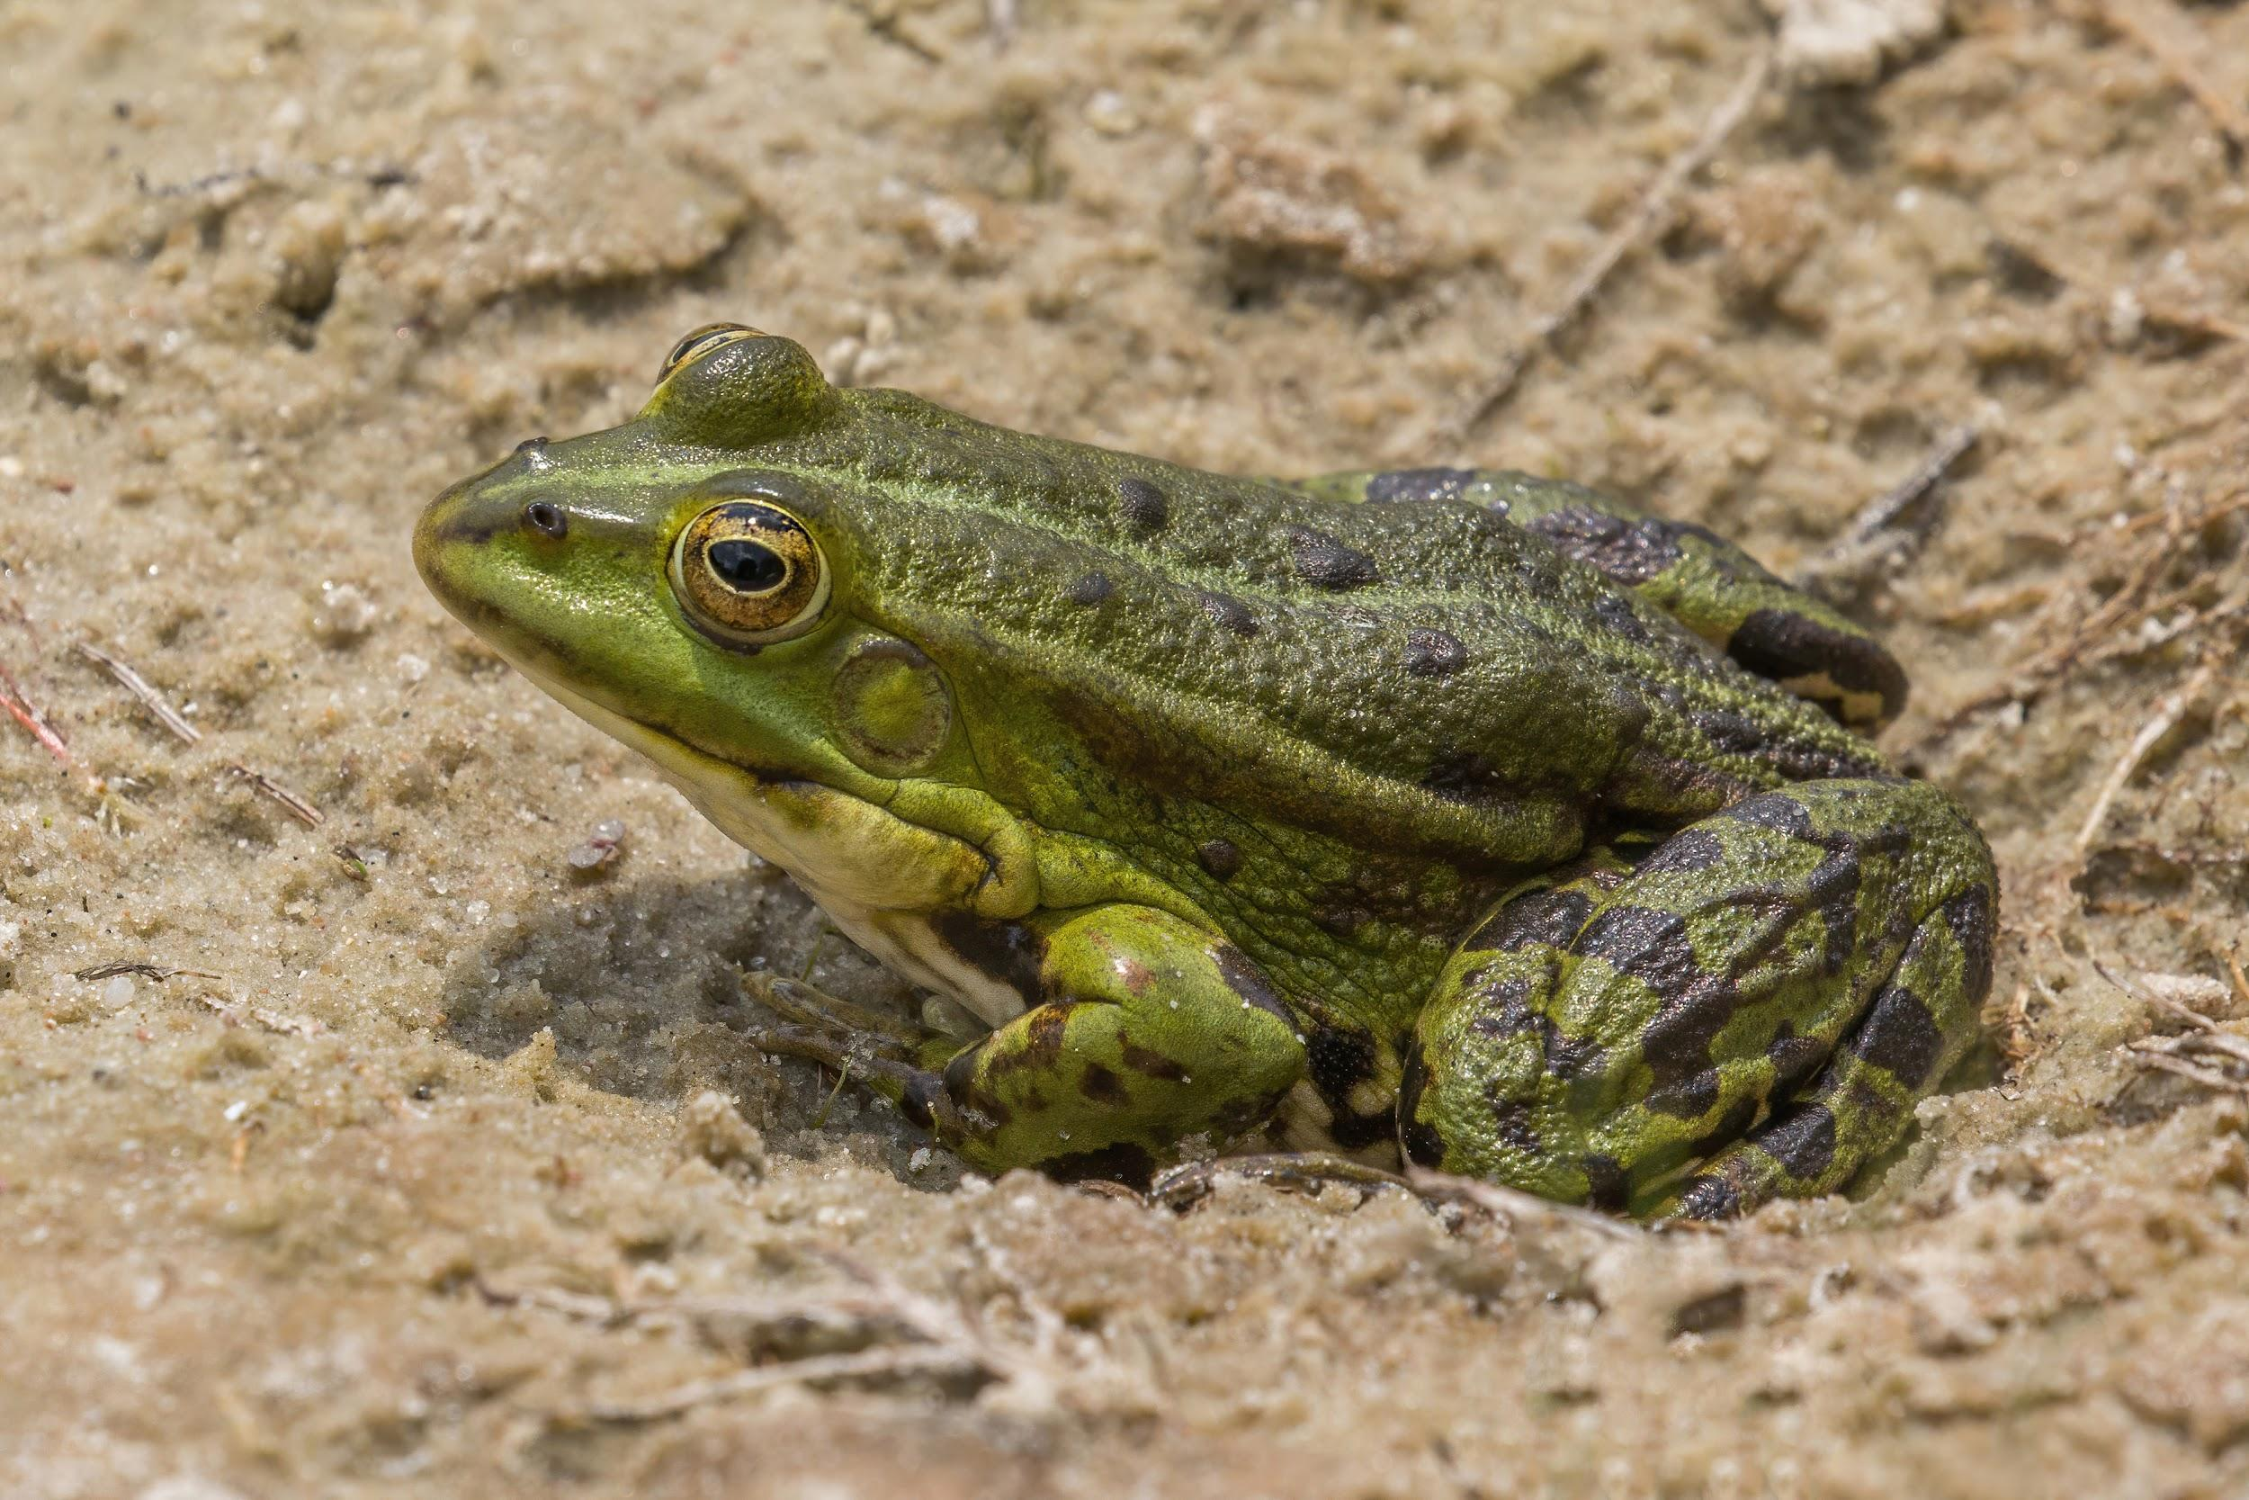
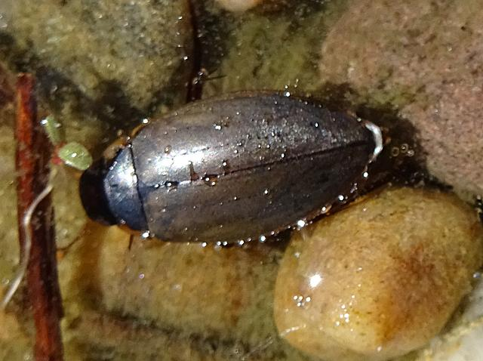

Slide 11


Slide 12
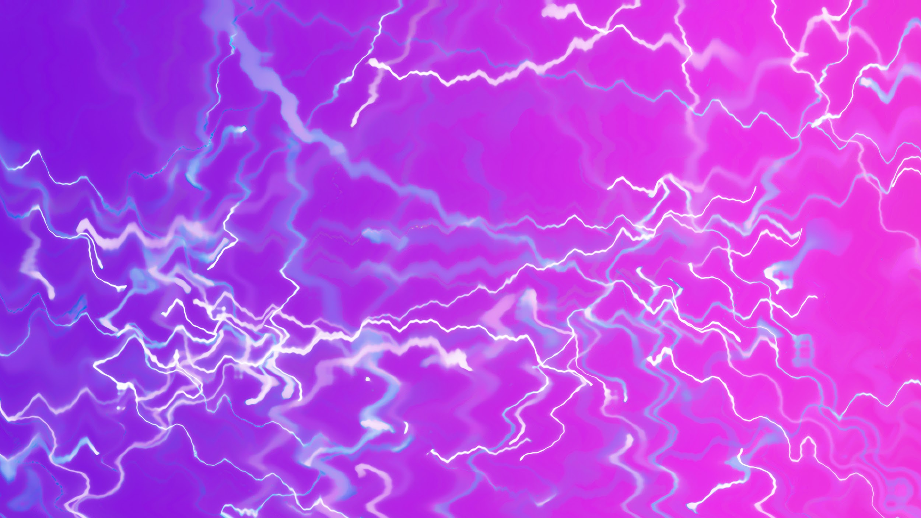
1.Why is littering bad?
2.How can you help the planet?
3.What can happen when litter gets in the ocean?

Slide 13

Answers
1.it can get in the sea and kill animals
2.Do litter picking
3. It can kill animals

Slide 14
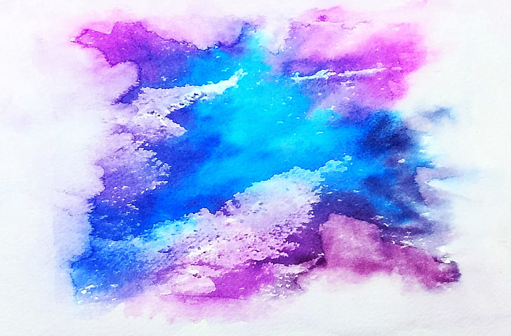
The end
Thanks for watching!!!!!

