Slide 1
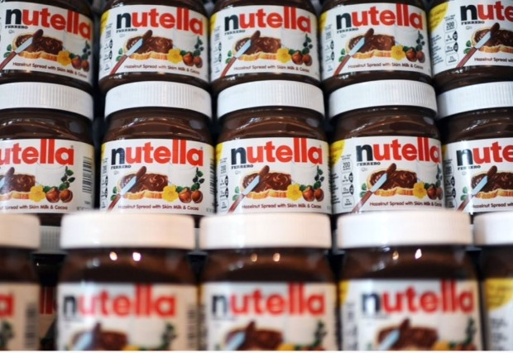
Palm Oil - What I know by Beau Vernon

Slide 2
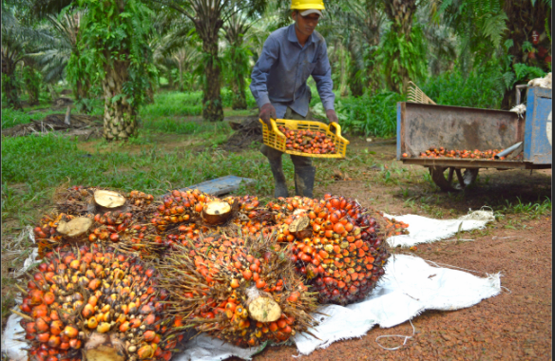
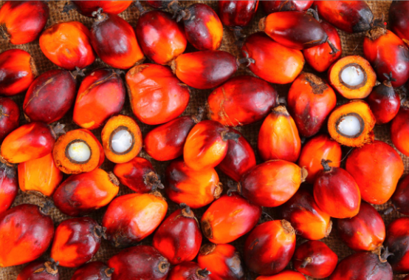
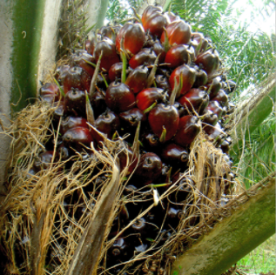
What does Palm Oil look like?
Palm oil comes from the fleshy fruit of oil palms. Unrefined palm oil is sometimes referred to as red palm oil because of its reddish-orange color
Palm oil trees are native to West and Southwest Africa
The biggest producer of palm oil is Indonesia

Slide 3

What is it?
Found in everything from shampoo to donuts, palm oil is now the most common vegetable oil in the world—and also one of the world's leading deforestation drivers. Palm oil is extracted from the fruit of the oil palm tree, which thrives in humid climates.
Palm Oil is an ingredient added to many food products we all eat, you just don’t know it!
Why has it grown so much in popularity? I’ll tell you why:
Palm oil is a natural preservative, which means by adding it to all your food products you can give it a much longer shelf life. Very appealing to all food producers!
Palm oil is odourless! So when you add it to things, it doesn’t change the flavour of your product
Palm oil has a very appealing smooth and creamy texture
Palm oil is great for cooking, especially at high temperatures

Slide 4
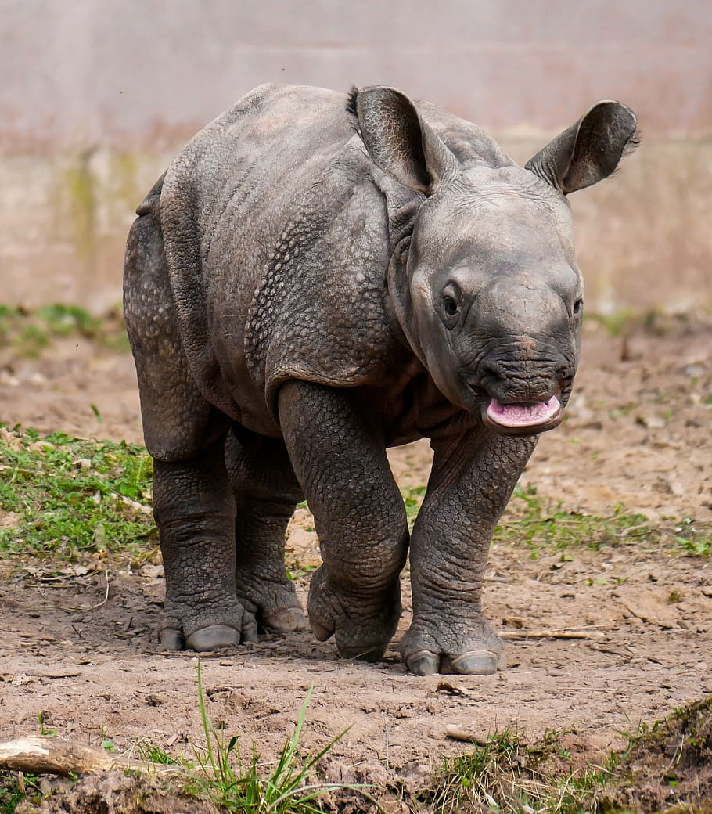
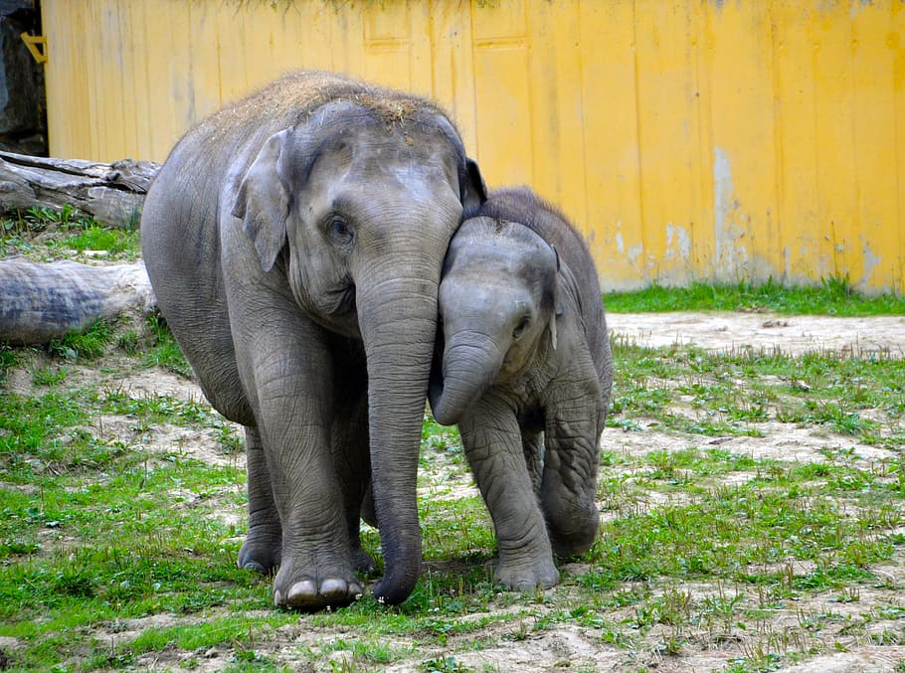
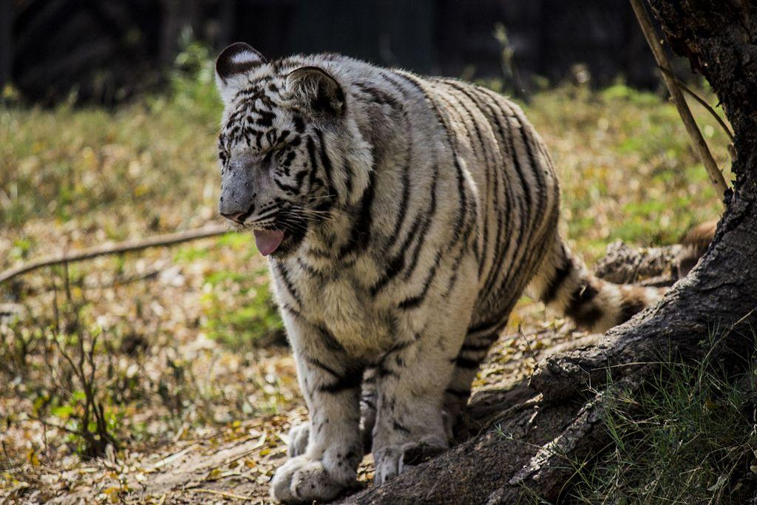

Why is it an issue?
Palm Oil plantations are rapidly removing the world of it’s vital trees and forests
In the past 16 years an estimated 100,000 Orangutans have died due to habitat loss directly linked to deforestation to plant more palm oil plantations
Not just the Orangutans but Elephants, Rhinos and Tigers are on the brink of extinction. Do we really need palm oil that much? Is there a better way to produce it that doesn’t mean we are adding to climate change by getting rid of trees and animal habitats?
70% of Earth’s land animals and plants live in forests
Plants/trees create oxygen and absorb greenhouse gases
Over 50% of processed goods contain palm oil, including, healthy, vegan and organic products — it’s in nearly everything, from soaps and cleaning products, to margarine and dog food

Slide 5
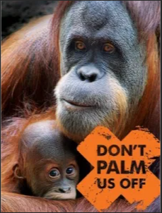
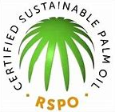
What can we all do about it?
Some types of palm oil are better than others when it comes to preventing deforestation.
Sustainable palm oil is much better for the environment than unsustainable palm oil.
Unsustainable palm oil means forests full of lots of different plants, animals and trees are cut down, whereas sustainable palm oil does not.
Sustainable palm oil plantations create special wildlife zones and do not clear any important forests.

Slide 6
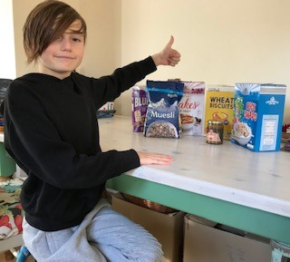
I found that quite a few cereals made by Lidl and Aldi were palm oil free. Aldi also sell the best tasting palm oil free peanut butter!
The Foodie Market (Aldi) peanut butter
Lidl Fruit flakes cereal
Lidl Rice crispies
Lidl Muesli
Lidl wheat biscuits (Wheetabix)
Lidl blueberry wheats

Slide 7
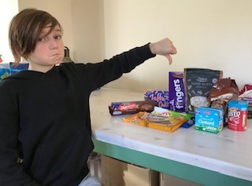

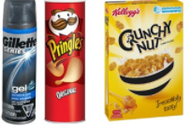
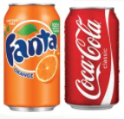


But quite a lot of our favourite food items contain palm oil…..
Cadbury’s chocolate fingers
Lidl Twix alternative
McVities Chocolate digestives
Sorren apple cake bars
Lidl ready made custard
Bisto gravy granules
Mars Galaxy chocolate cookies
Lidl Super Nutty Granola
Lidl Kinder Bueno alternative
Food producers to avoid:

Slide 8
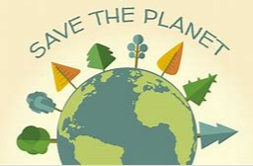

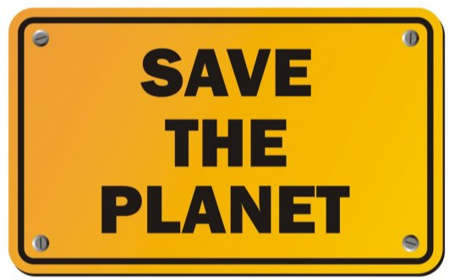
The charity GreenPeace is fighting climate change and deforestation:
As the biggest offender of deforestation, Indonesia holds so much precious wildlife and many plants only found there.
Indonesian forests store 300 million tons of carbon which is the same as 40 times the annual gas emissions from fossil fuels! Imagine if all these forest are cut down?
We can help support their efforts by avoiding foods that contain palm oil and palm fat. Look out for them next time you go shopping!
*WE CAN MAKE A DIFFERENCE*

Slide 9
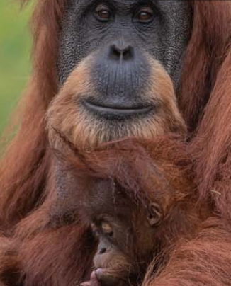
Please watch this short video and get inspired to help save your planet!
https://youtu.be/K6KOQjimVjA

