Slide 1
How can we keep ourselves safe?
Lets get into teams!

Slide 2
What are the dangers for young people today? (bonus points if you say one of these)
Bullying
Strangers
Busy roads/ cycling
Internet safety/ social media

Slide 3
Internet safety/social media
Let’s talk about…
Positive uses of internet and social media
Harmful impacts of the internet and social media

Slide 4
How can we keep ourselves safe on the internet and social media?
https://www.st-petersoxon.co.uk/esafety/
Did you know we have a section of the school website for internet safety?

Slide 5
Workshops – we will work on these projects to share with parents
Apple – Mrs Houghton
Oak – posters – competition prize/website
Maple – ebook comics - website
Willow – radio play for Oxford Hospital Radio

Slide 6
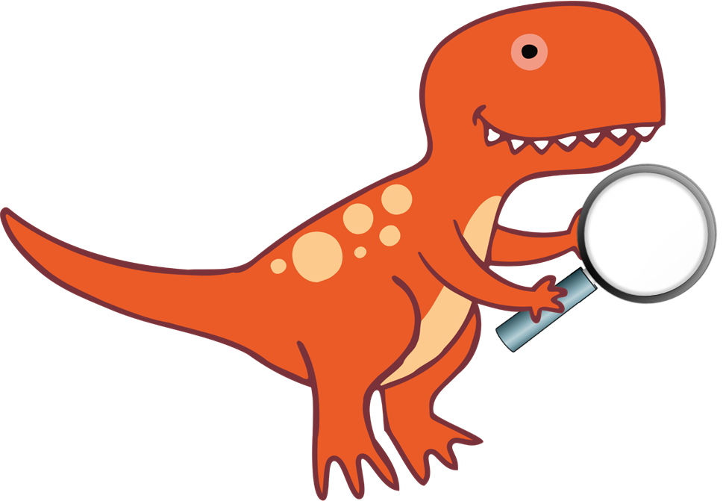
St Peter’s Dino digital detectives
We need you to help everyone keep safe!
- If you’ve heard about something on the internet, seen a new craze that might be dangerous, or just want to share some top tips to keep safe, fill out a form and take it to the office.
Class reps will meet with Jay once every 2 weeks
- We will update the website and have a section of the newsletter so we can share the information

