Slide 1
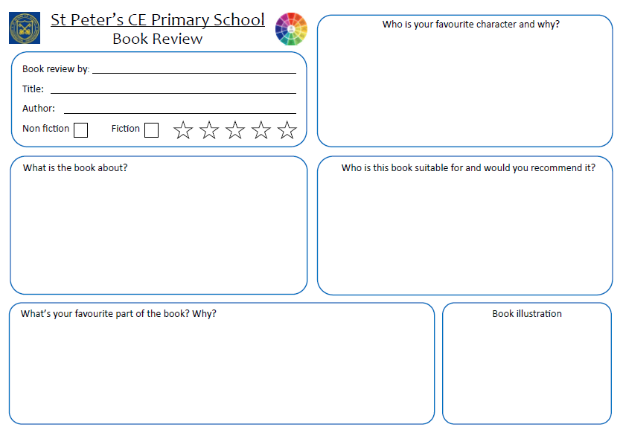

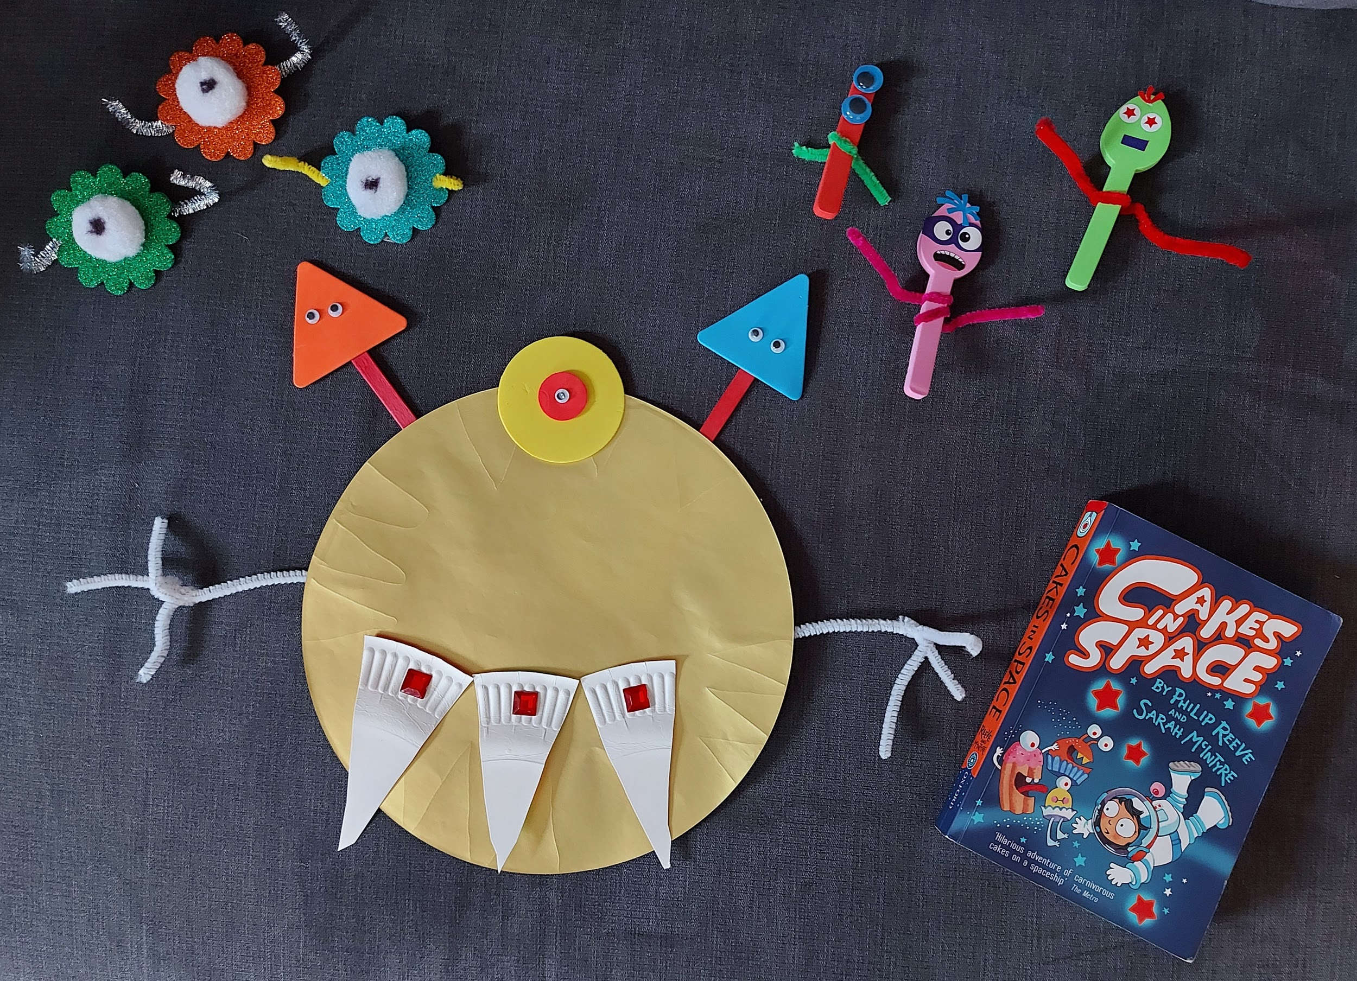
My favourite character is Astra because she is very funny at the start. When her mum tells her they are going to be traveling for for 199 years, she screams. She doesn’t want to be frozen in time and her reactions about missing her friends is really funny. I know, I would react the same way!
Lorelai Taylor
Cakes in Space
Philip Reeve & Sarah McIntyre
The book is about a girl called Astra that goes on a spaceship with her family to go live on another planet. But she meets some mysterious creatures on the way. She travels for 199 years and falls asleep for all of it. Is it just a dream, or are there really alien cakes in space?
It is suitable for 6 and up because it has lots of pictures and it is a funny book. It hasn’t got a lot of hard words so it is easy to read. The descriptions are clever and sometimes make me hungry! Who doesn’t like cake? Even if it is an alien. I would definitely recommend this book, it is so easy to read and understand.
My favourite part of the book is when they go through the tube to get onto the main ship. The thought of Astra floating around in space, with cakes, forks, spoons and slimy gloob all around her sounds like really good fun, and the type of adventure I would like to get involved in.

