Slide 1

Welcome to Maple Class

Slide 2
Reading
Spellings
Mathletics
Homework
Times tables
PE
Trips

Slide 3
Reading
In years 3 and 4, we expect pupils to read 4 times a week for 15 minutes. They will have reading journals that we will check each Monday to see how they’re finding reading and their books. They will also have the opportunity to find a new book (if needed) from our reading corner on a Monday. Might be easiest to use book bags, but can use a normal school bag.
Some children will take part in frequent one-to-one reading with volunteer readers, TAs and myself, some children will read in small group interventions and everyone will take part in whole class reading – normally on a Friday.
If your child has a book that they find too easy or too difficult please get in touch and we will help them to find a book more suitable! Some will be continuing to read the RWI books.
We will restart reading challenge to achieve team points and badges.
Books must be in school every day and the children need to let us know if they need a new book before the next Monday.

Slide 4
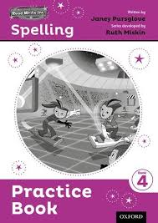
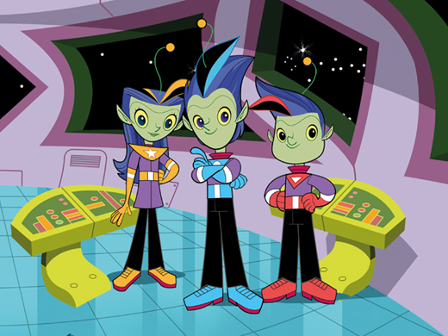
Spellings
In KS2, we continue to follow the Read Write Inc spelling scheme. Both years will work altogether, first on the blue books and then later in the year, we will move onto the purple books.
Some children will be continuing with phonics interventions and will have spellings individual to them.
Each week we will be focusing on a different spelling rule or pattern.
Every Monday children will be given their new list of spellings and will be tested the next Monday. Some weeks the list will include words from the National Curriculum Year 3 and 4 statutory spelling list and key words from our topic or science work.
Spellings will be printed as paper copies, but will also be on google classroom.

Slide 5
Maths homework - Mathletics
Login details will be given to all children in Maple class (we will send these home) and we will log in and explore the page, so they know what to expect.
We are setting specific activities every Friday for the following Thursday that are based around the learning in maths lessons, problem solving activities or times tables.
Mathletics is an excellent on-line tool to support mental maths speed and accuracy.
We also have times tables recall every Friday and the children get time to practice these at least once a week on Times Tables Rockstars.

Slide 6


Slide 7
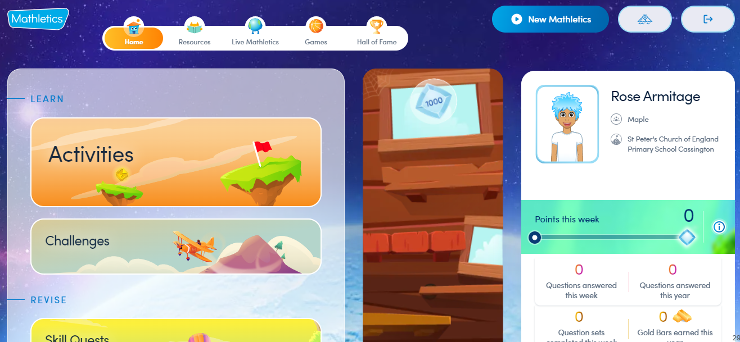

Slide 8

Homework
Sometimes we will give out homework linked to our topic work. It will be set on google classroom, but we will remind children in class. If google classroom or mathletics are not easily accessible, we can provide homework books and a physical copy for the children to complete.
Year 4s will complete the multiplication check in June. It’s really important they practice their times tables regularly – at least once a week now, but this should increase throughout the year.
Times tables are tested on Fridays.
Weekly arithmetic tests take place on Fridays – some children ask for additional papers to take home!

Slide 9

Times tables rockstars
The children should practice on TTRS at least once a week – particularly year 4.
There are different zones. For example, they can take it easy and just ‘jam’ or they can try and create a rock status – I don’t mind which zone they choose currently as long as they are playing. By the summer term, year 4s will need to complete the sound check regularly.
I can monitor their effort and attainment and every Friday will print off certificates for those who have made a real effort.
I might also set challenges to see if they can beat the teacher!

Slide 10
PE days
Monday and Tuesday PM. Monday with Mrs Glass and Tuesday with myself.
We try to go outside as much as possible (unless our topic is gymnastics) so please can your child have some PE trainers each day.
Can leave PE kits in school.

Slide 11
Topics for the year
Autumn term – Local study exploring Cassington, Witney and Oxford – map reading.
Spring term – The Romans.
Summer term – Extreme Earth.

Slide 12
General timetable
 | Monday | Tuesday | Wednesday | Thursday | Friday
AM | RWI, spelling test English Maths | RWI, spellings or grammar session English Maths | RWI, spellings or grammar session English Maths | RWI Times tables practice English Maths | Times tables test Arithmetic test English Maths
PM | RE PE | PE Mandarin and reading interventions | Science | 99 club – quick mental maths Topic/Art/DT/Computing | Whole class reading PSHRE Music

Slide 13
Trips/Events
Trip to the Story Museum – September
Linked to our creative writing in English
Milestone moments – Bring your pet to school day – December
Link to science topic on animals and living things
Trip to Chedworth Roman Villa – Feb/March
Linked to Roman topic
Trip to a Hindu Mandir – March/April/May
Linked to RE

Slide 14
Key points
- Spellings are set on a Monday, given as a sheet and on google classroom.
- Spellings are tested on a Monday.
- PE days are Mondays and Tuesdays.
- Maths homework is set on a Friday on Mathletics – or a sheet if needed.
- Maths homework should be done by the following Thursday.
- Frequent practice on TTRS.
- Snacks – fruit, fruit alternatives e.g. yoyo bars, cereal bars, but no chocolate.

Slide 15
Useful links
https://login.mathletics.com/
https://play.ttrockstars.com/auth/school/student/37403
https://www.timestables.co.uk/
https://www.topmarks.co.uk/maths-games/hit-the-button

Slide 16
Monday | Tuesday | Wednesday | Thursday | Friday
AM - Previous weeks spellings tested PM - New spellings set |  |  | Previous Maths homework returned | New Maths homework set
Homework Timetable

