Slide 1
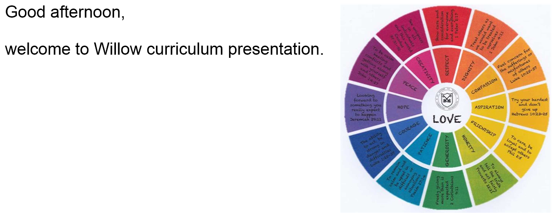

Slide 2
English
Spellings/SPaG
BREAK
Maths
LUNCH
Wider curriculum:
Whole class reading/Mandarin/PE/Topic
/Science/Music/Art/Computing/PSHE

Slide 3

Whole School Overview by Year group – Willow Cycle B

Slide 4
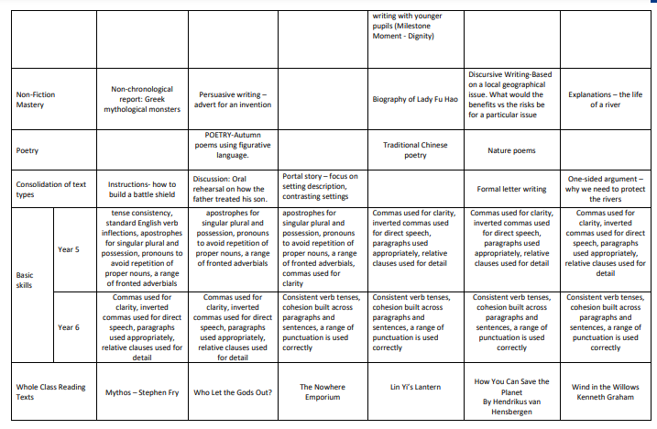

Slide 5
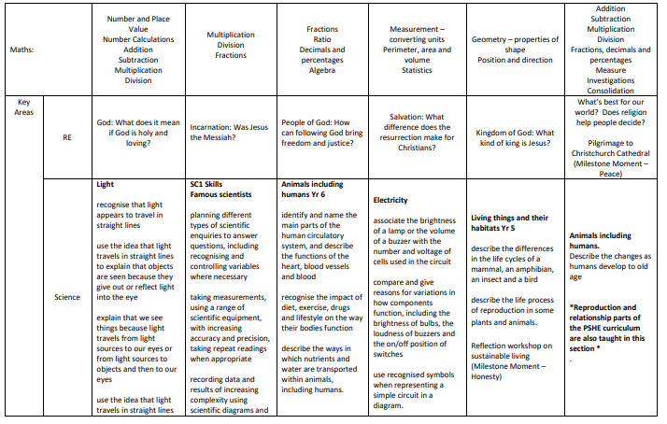

Slide 6
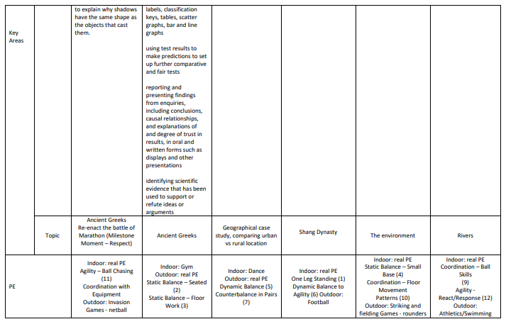

Slide 7
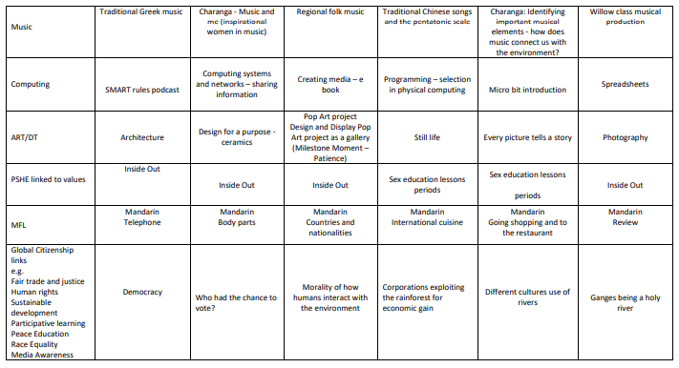

Slide 8
Reading
In years 5 and 6, we expect pupils to read around 5 times a week for 15 minutes but reading a little every day will be hugely beneficial. They will have reading journals that we will check each Monday. If they have read:
10 pages = 1 TP 30 pages = 3 TPs 50 pages = 5 TPs
Either yourself or your child can record the dates and pages that they read. Comments on reading not hugely necessary – unless new language has been explored perhaps!
Some children will take part in frequent one-to-one reading this term, some children will read in small group interventions and everyone will take part in twice weekly whole-class reading sessions.

Slide 9
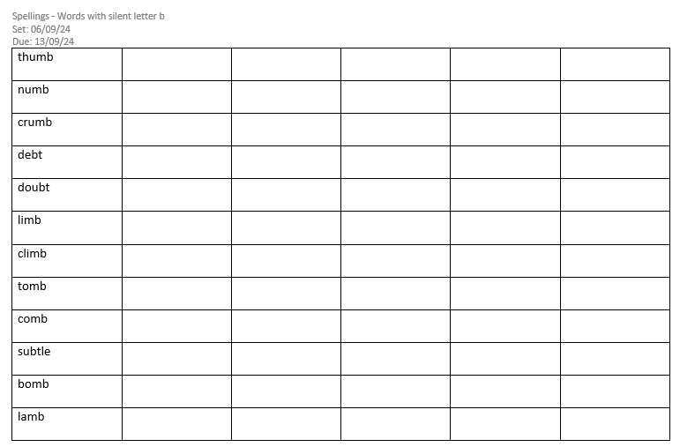

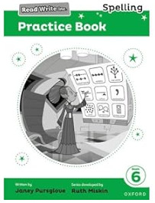
Spellings
In Willow, we continue to follow the Read Write Inc spelling scheme they did in years 1/2 for phonics and in years 3/4 for spellings.
Each week we will be focusing on a different spelling rule or pattern.
Every Friday children will stick their new list of spellings into their orange homework books and will be tested the next Friday. Some weeks the list will include words from the National Curriculum Year 5 and 6 statutory spelling list and key words from our topic or science work.

Slide 10
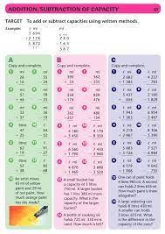
Homework
In addition to reading and spellings, a maths sheet will also be stuck into your child’s book on a Friday and will need to be completed and ready to mark by the following Friday.
They need to choose at least one section to complete.
We will also set termly topic homework that should inspire the children to work creatively and to complete some independent research around a topic.
Although times tables are not tested weekly, they are still invaluable in supporting children with their maths. We will therefore award three times tables rockstar effort certificates every half term to award those continuing to practise.
Weekly arithmetic tests take place on Fridays.

Slide 11

PE days
PE will take place on Tuesday and Thursday afternoons.
We ask that the children have their PE kit in all week and take it home over the weekend for washing.
PE kit – white top, black/navy shorts, joggers and jumper.
We try to go outside as much as possible (unless our topic is gymnastics) so children should ensure they have outdoor trainers for PE lessons.

Slide 12
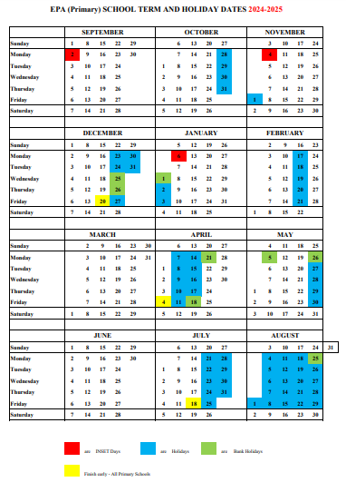
Key Dates this term:
Year 6 Bikeability 16th – 17th September
Bart’s open evening 19th September 5pm-8pm
23rd September Junior Citizens
Years 5/6 Parents Evening 22nd and 23rd October
Year 5/6 Residential – Yenworthy 9th – 13th December
Year 6 Bartholomew transition days:
Thursday 24th April
Thursday 26th June
Friday 27th June

Slide 13
Other Trips/Events
History Visit/Ashmolean – Ancient Greece – October
Trip to Compton Verney – Shang Dynasty – 27th February 2025
Nature walk and the countryside code and a trip to Christchurch Cathedral – Rivers topic and RE – Summer term

Slide 14



Slide 15
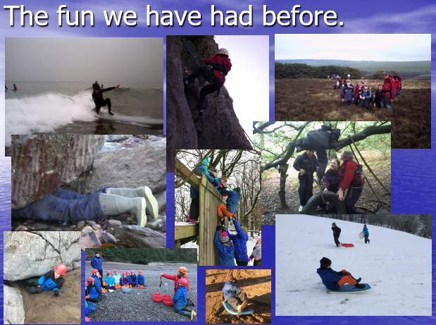

Slide 16
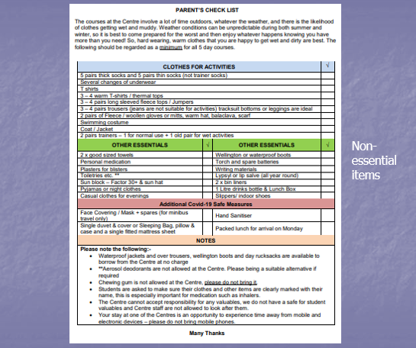
We will re-assess kit list to ensure all items are still necessary and send out our updated version just before October half term.
The majority of items are available from the centre – day trip bags, coats, waterproofs and wellies.
Layers!

Slide 17
Key points
Reading records are checked on a Monday and team points are awarded.
Spellings are set on a Friday and tested on a Friday.
Maths homework is set on a Friday and checked on the following Friday – at least one section A, B or C.
PE days are Tuesday and Thursday.
Water bottles.

